Slide 1
William and Catherine Booth

Slide 2
Soup, soap and salvation

Slide 3
Farthing breakfasts

Slide 4
Soup kitchens

Slide 5
Match factory

Slide 6
Homeless shelters

Slide 7
Jobs and training

Slide 8
Thrift shops

Slide 9
Brass bands

Slide 10
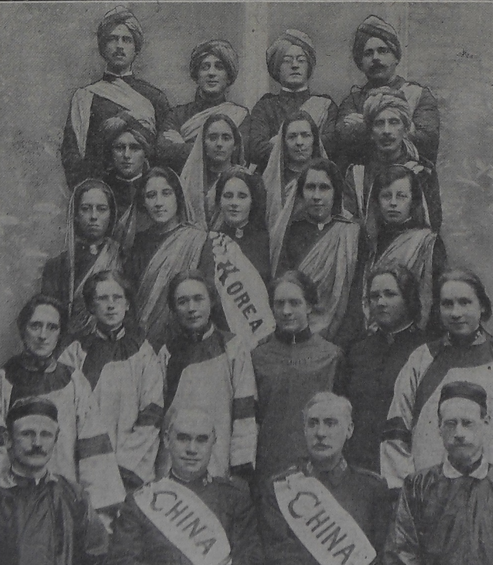
International

