Slide 1
Welcome
to
Assembly
Schools and
Colleges
Unit

Slide 2
What do you love the most?

Slide 3
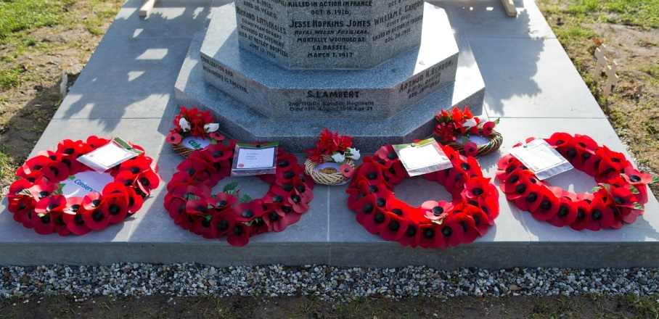
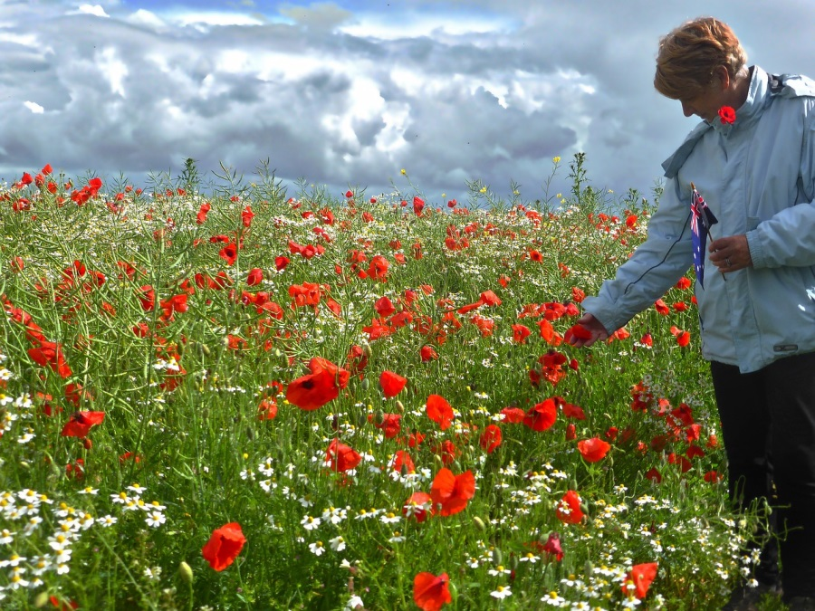

Slide 4
The greatest love
you can have
for your friends
is to give your life for them.
GNT

Slide 5
If you could say thank you,
what would you say?

Slide 6
Schools and
Colleges
Unit

