Slide 1
POWER
Schools and
Colleges
Unit

Slide 2
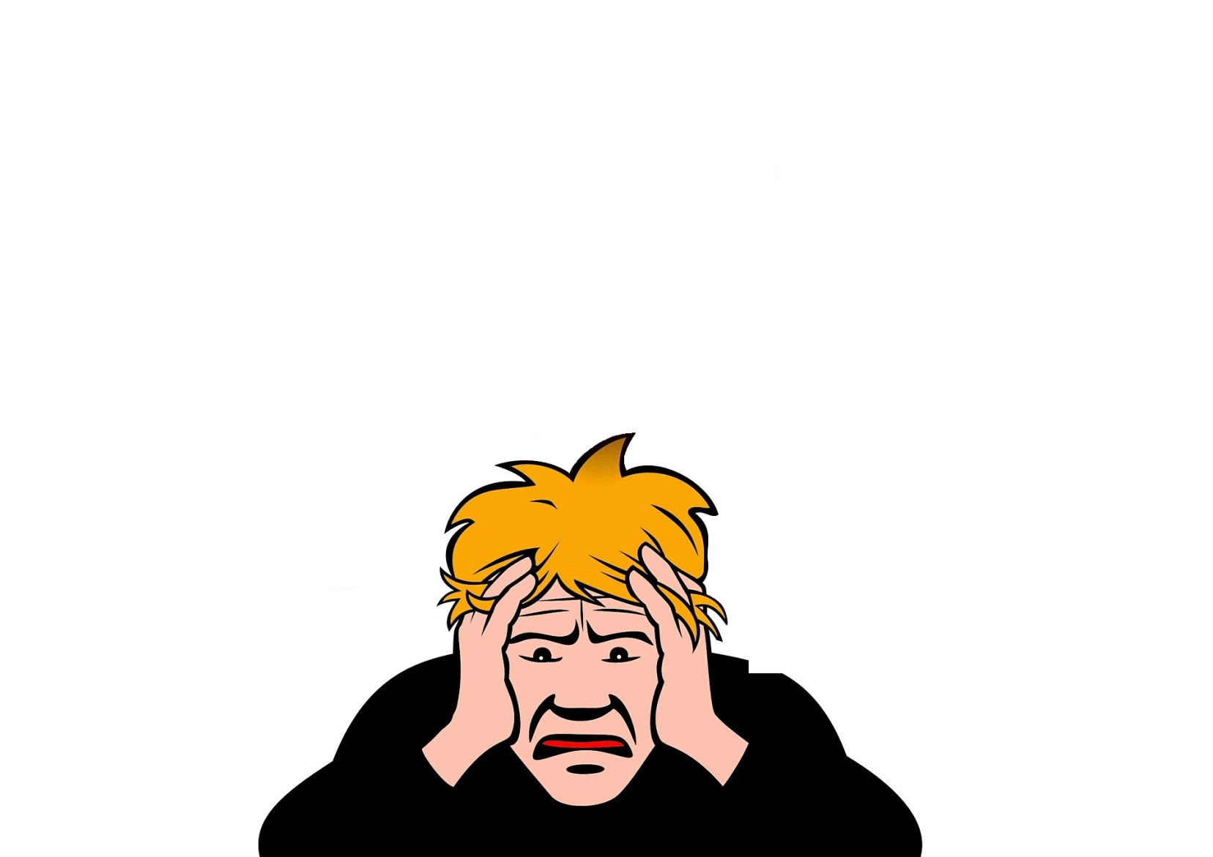
Challenge time
Take a seat!

Slide 3
POWER
Pentecost

Slide 4
Jesus returns to Heaven

Slide 5
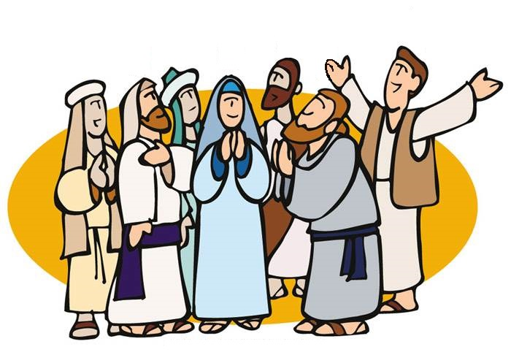
The disciples found
the power

Slide 6
Challenge and
Reflection
POWER
Can you find the power you need to succeed inside?

