Slide 1
REMEMBRANCE DAY

Slide 2
YOUR HOMEWORK?

Slide 3
A FAMILY MEMBER’S BIRTHDAY?

Slide 4
SOMETHING A FRIEND WAS GOING THROUGH?

Slide 5
SOMETHING SOMEONE HAS DONE FOR YOU?

Slide 6
WHAT ARE WE REMEMBERING?

Slide 7
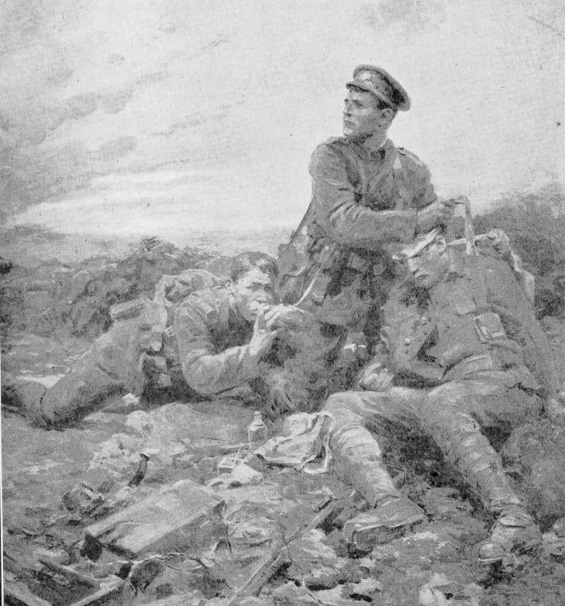
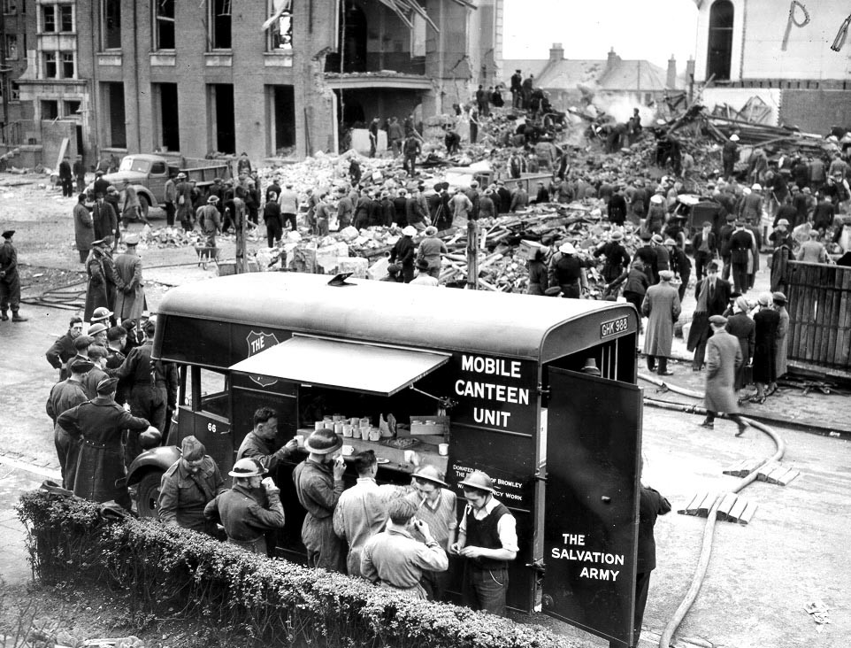
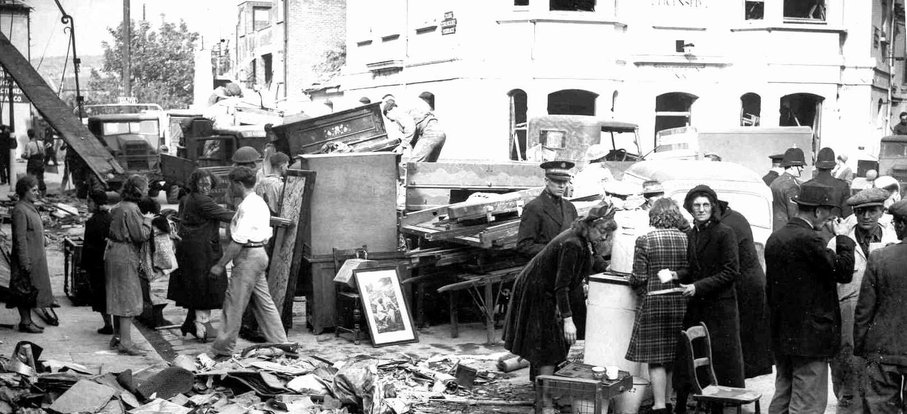

Slide 8
‘Peace I leave with you; my peace I give you. I do not give to you as the world gives. Do not let your hearts be troubled and do not be afraid.’
John 14:27 NIV

Slide 9
REMEMBRANCE DAY

