Slide 1
Schools and
Colleges
Unit

Slide 2
What part did you like?
What part surprised you?
Why did no one help Mr Trendy?
Why did Mr Lonely help him?

Slide 3
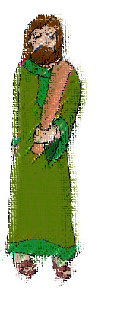
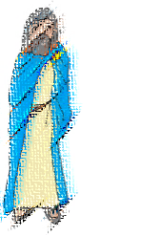
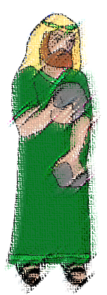
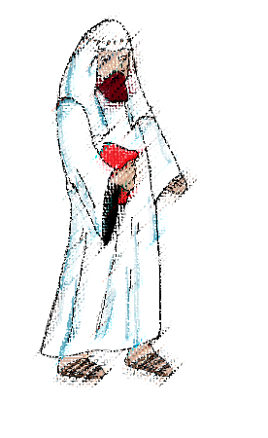
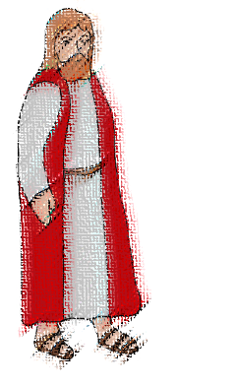
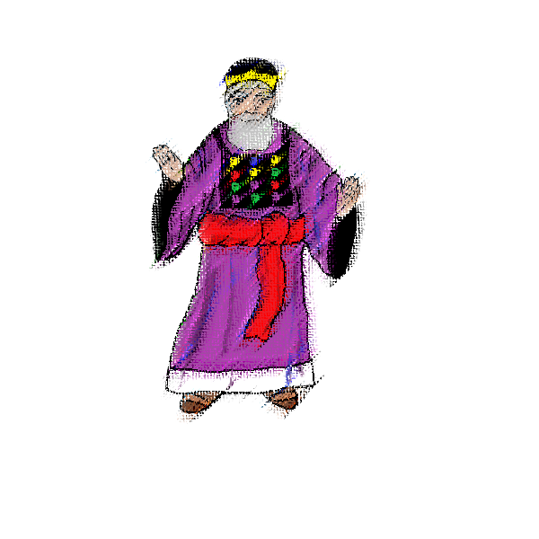
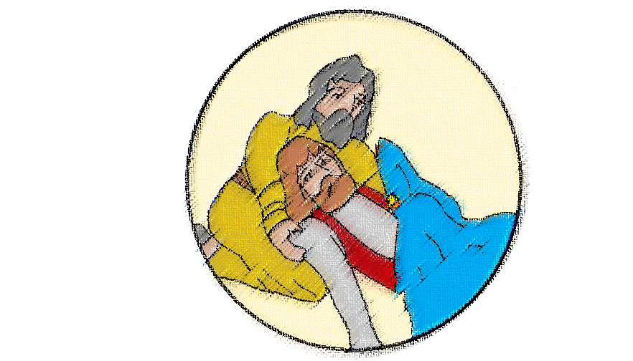
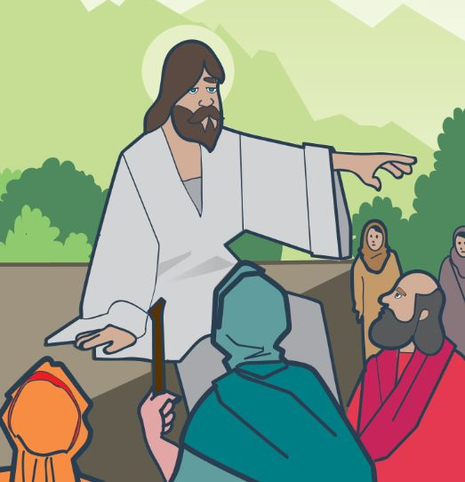
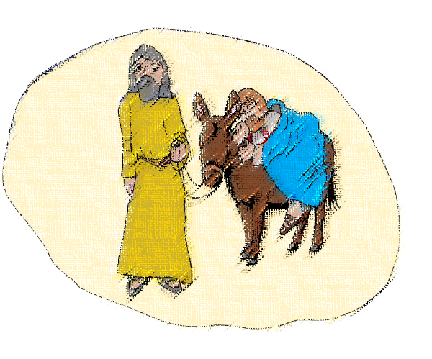

Slide 4
Love your neighbour
as yourself
Luke 10:27

Slide 5
What kind of person might be in need of help?

Slide 6
What is a refugee?

Slide 7
A refugee is someone who has fled their country because they will not be safe there anymore.
This is because they will be persecuted because of their race, religion, their social group or political opinion.
Persecute means:
to mistreat, harass, and punish unfairly

Slide 8
food
clothes
drink
incase you get lost
how to keep warm
a keepsake
medicine
How would you feel, if you were a refugee, starting on this journey?

Slide 9
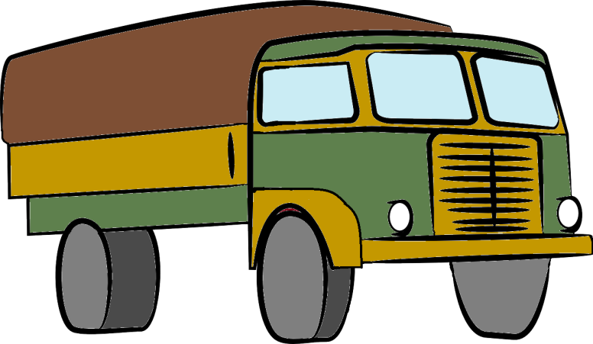
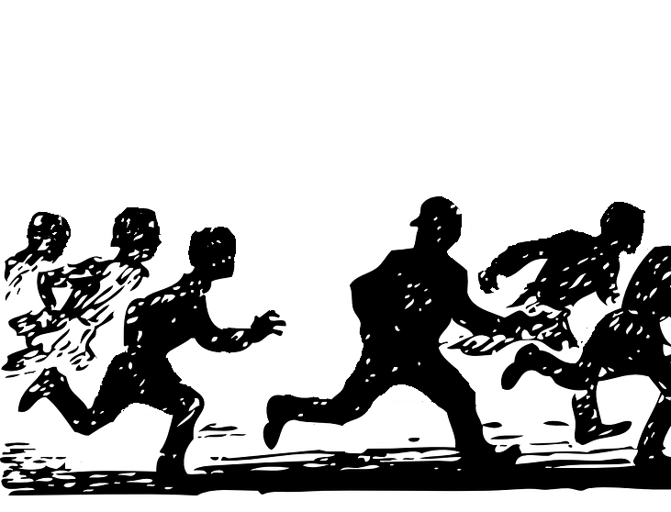

Slide 10
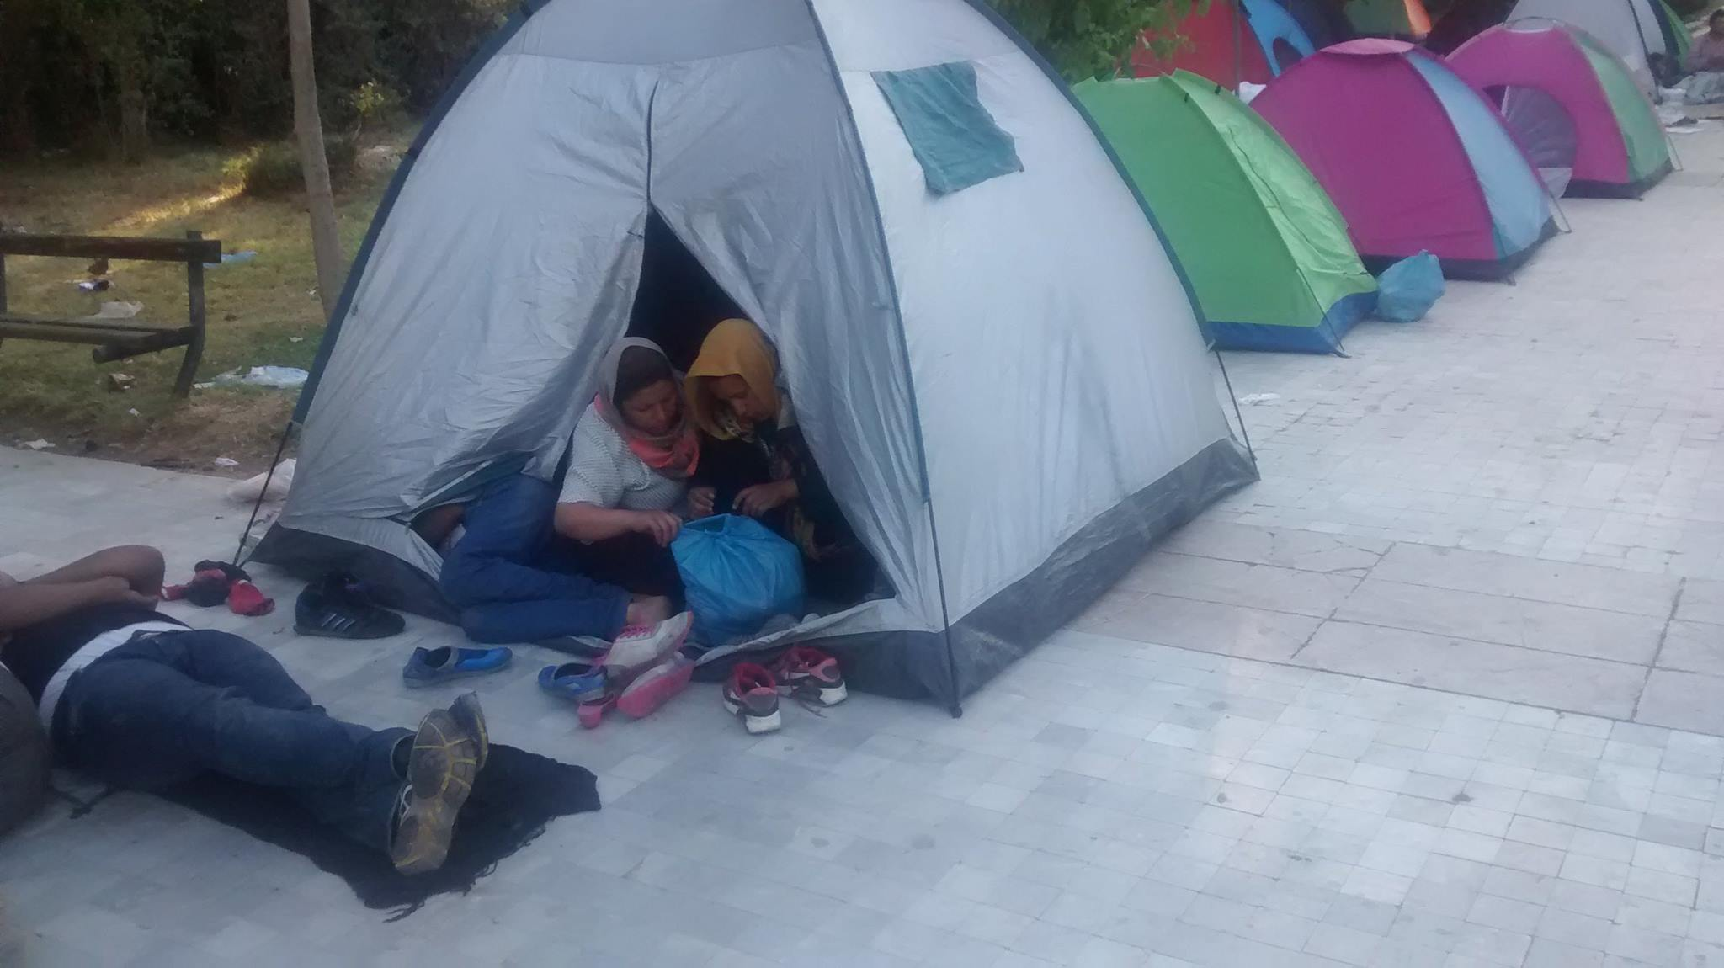
Imagine you are in this photograph
What do you notice?
What are you feeling?
What are you doing?
Why?
What are you thinking?
Write your ideas around the photo

Slide 11
If you are a refugee,
what might you need?

Slide 12
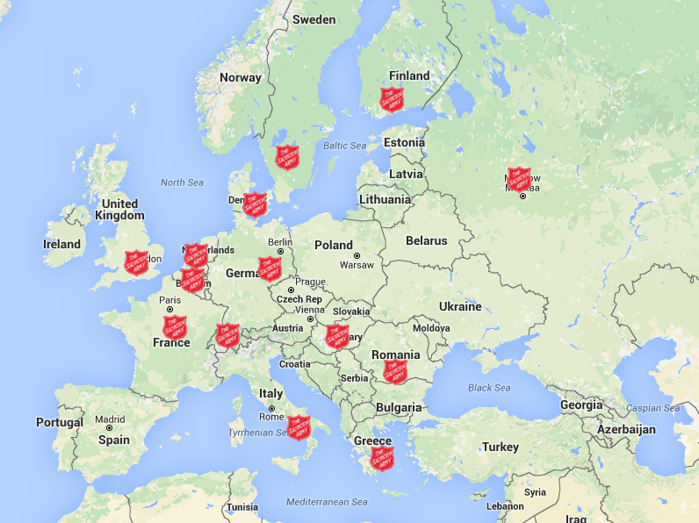

Slide 13
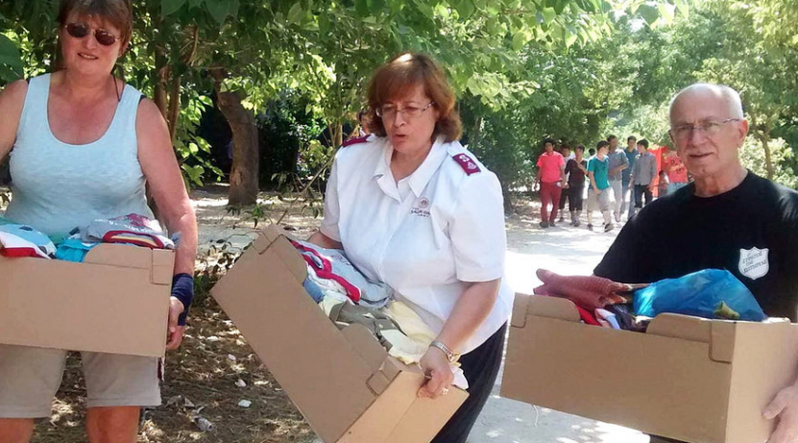
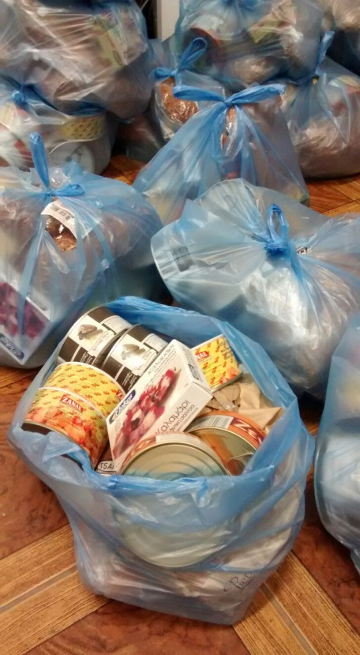
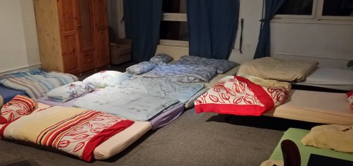
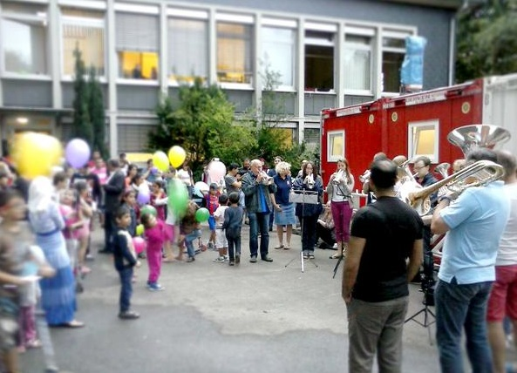
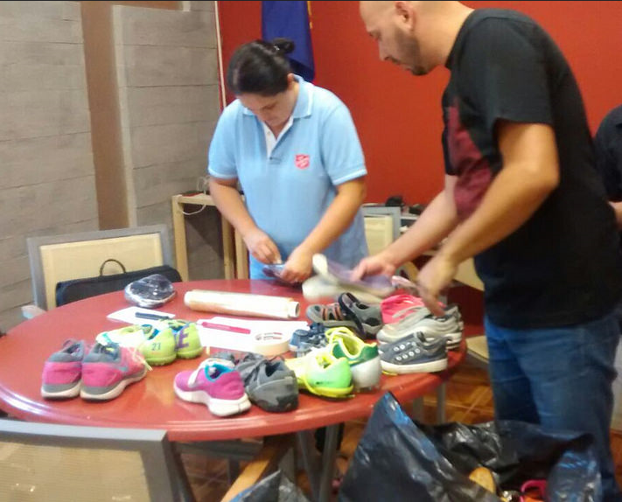
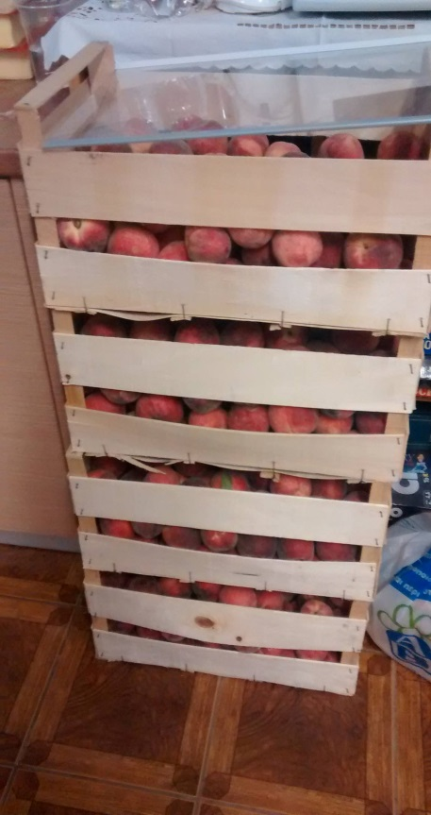
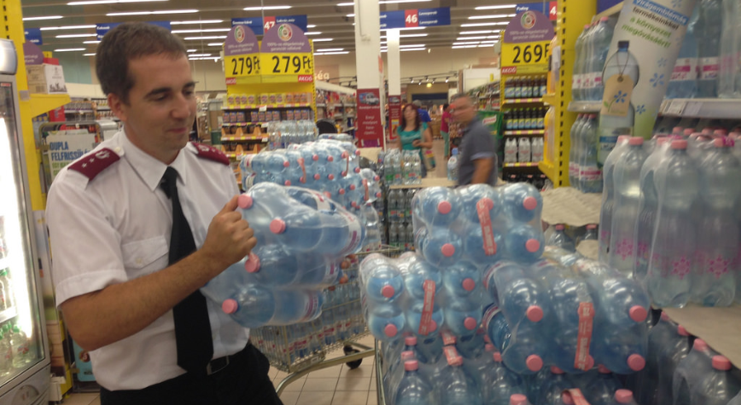

Slide 14
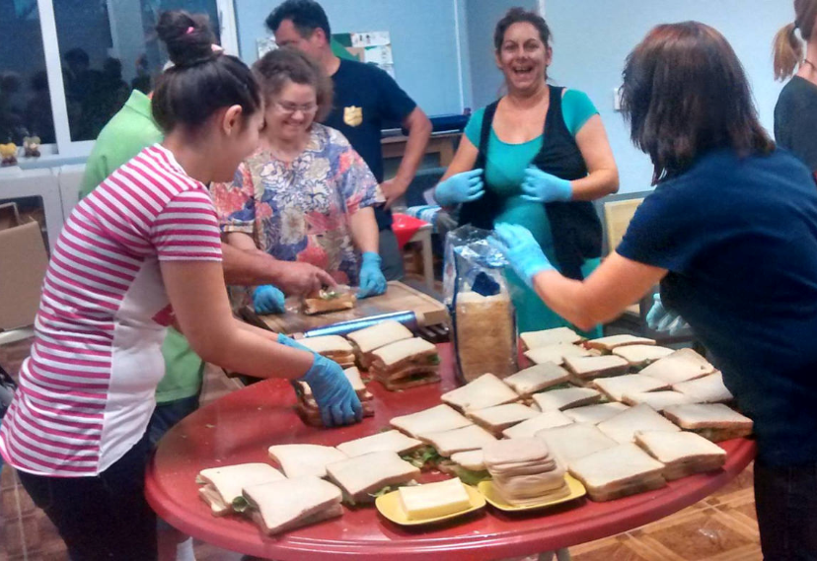
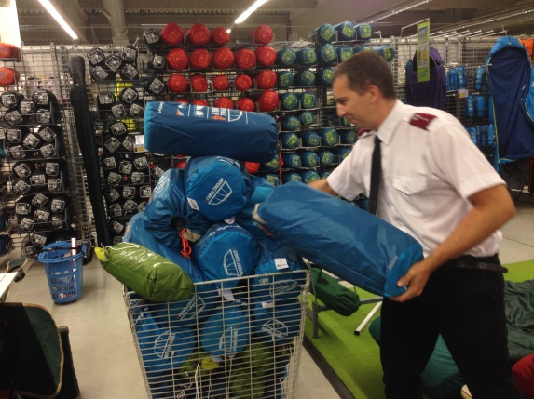
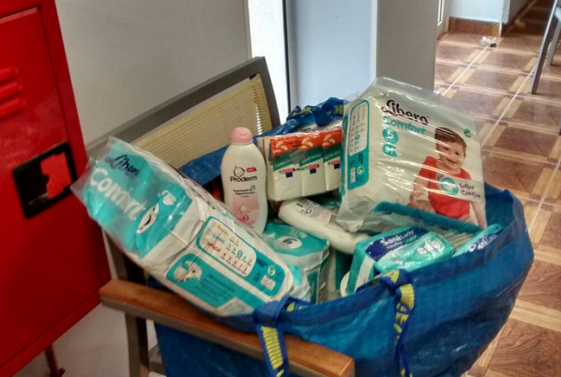
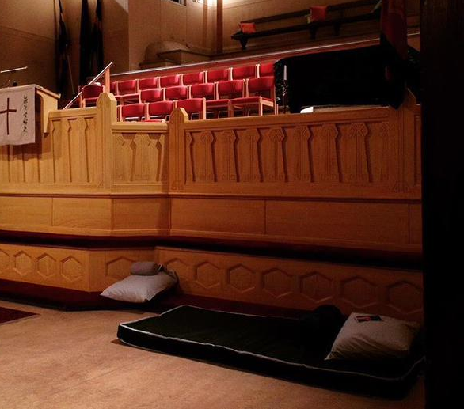

Slide 15
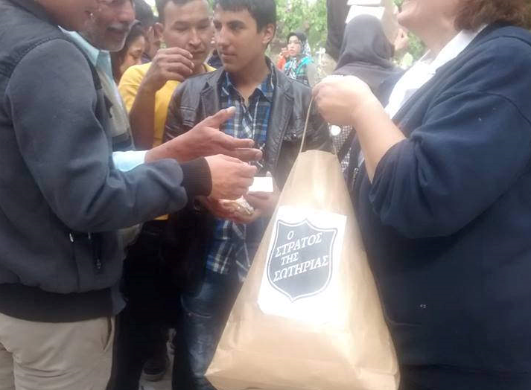
Why is The Salvation Army
Helping refugees?

Slide 16
What can young people do to support?

Slide 17
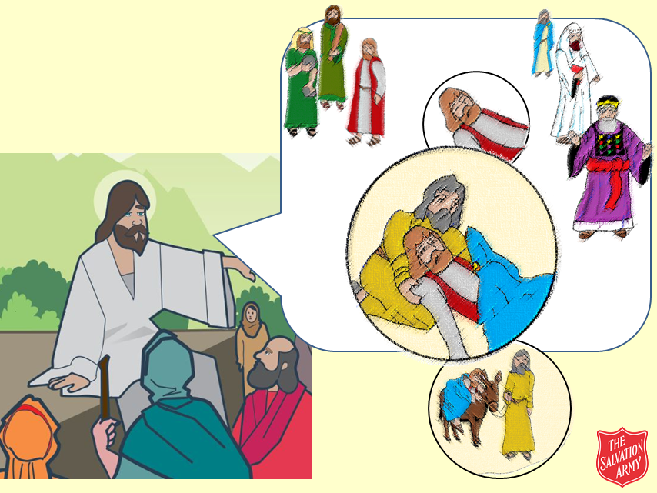
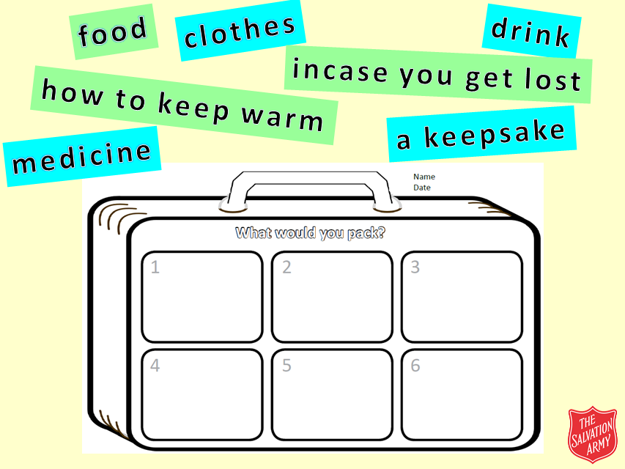
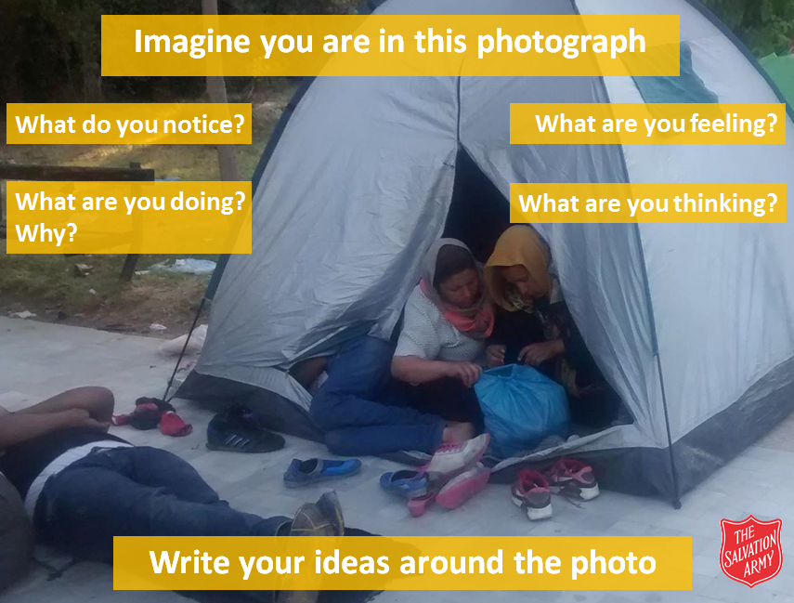
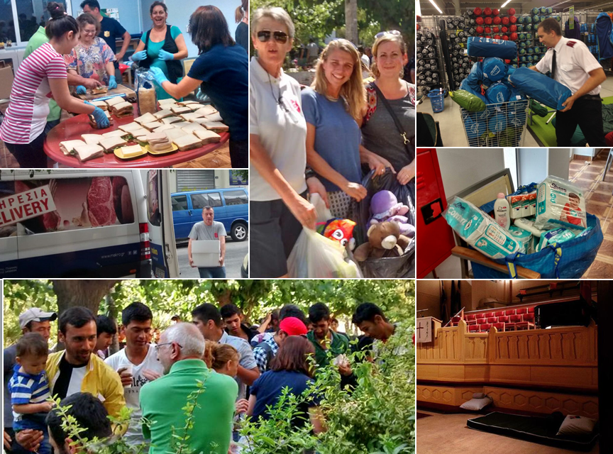

Slide 18
Schools and
Colleges
Unit

