Slide 1
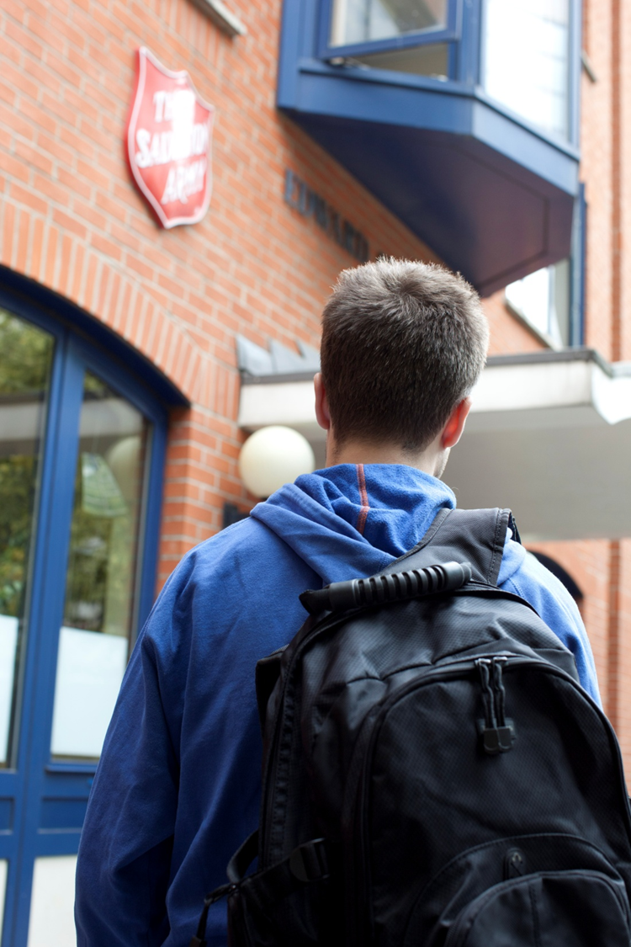
HIDDEN HOMELESS
What does homelessness look like?
Schools and Colleges Unit

Slide 2
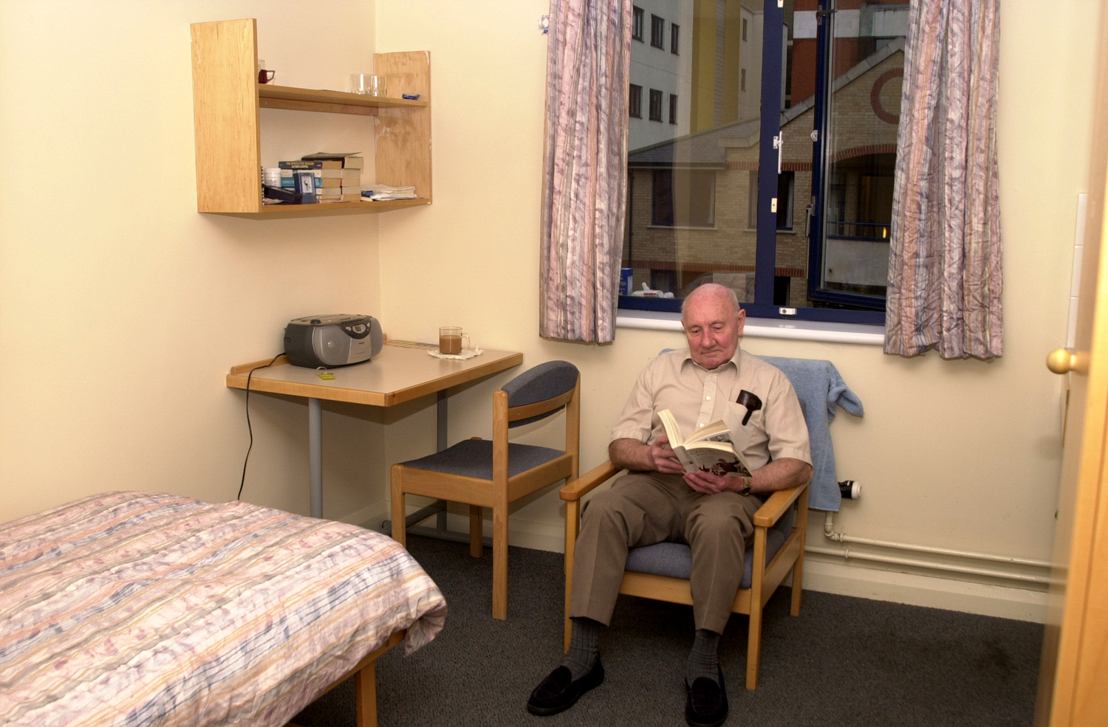

Slide 3
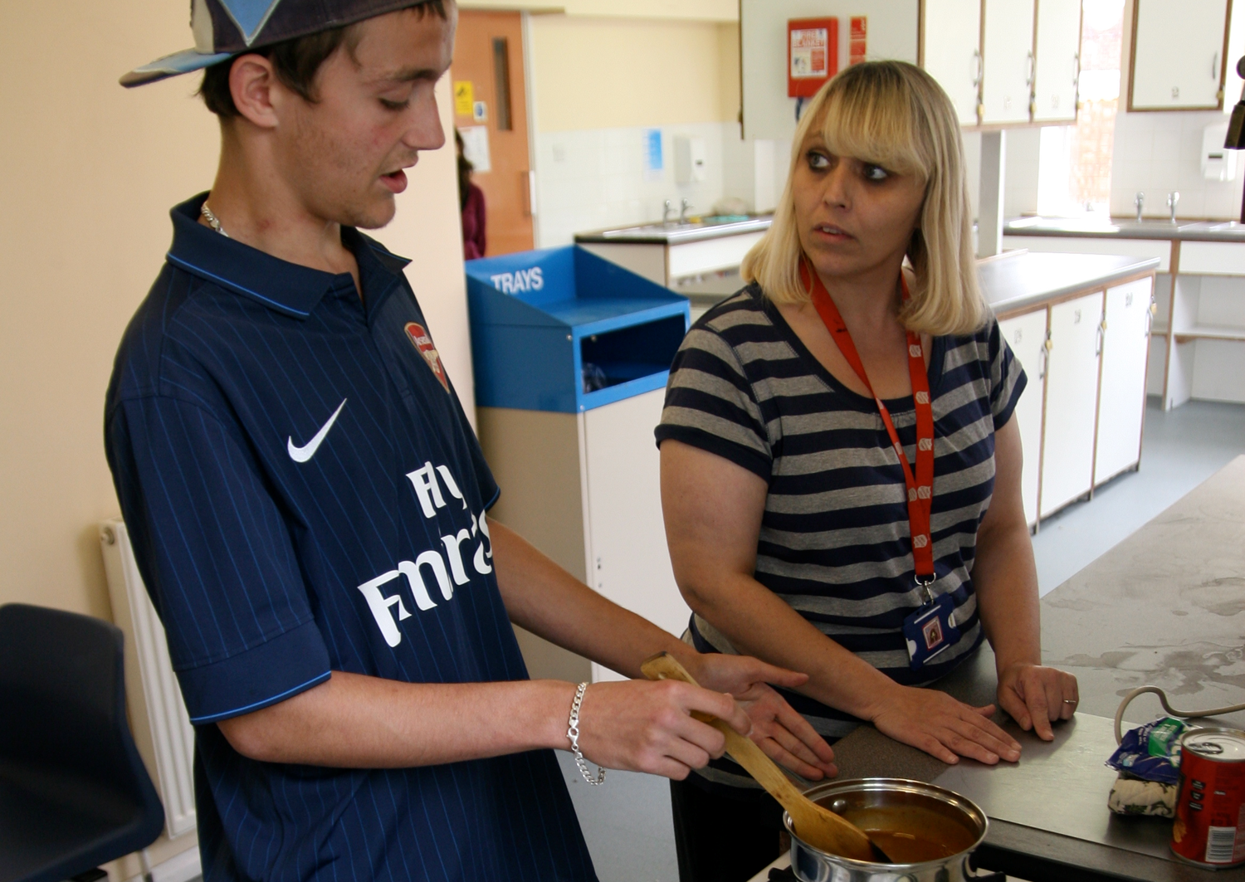

Slide 8
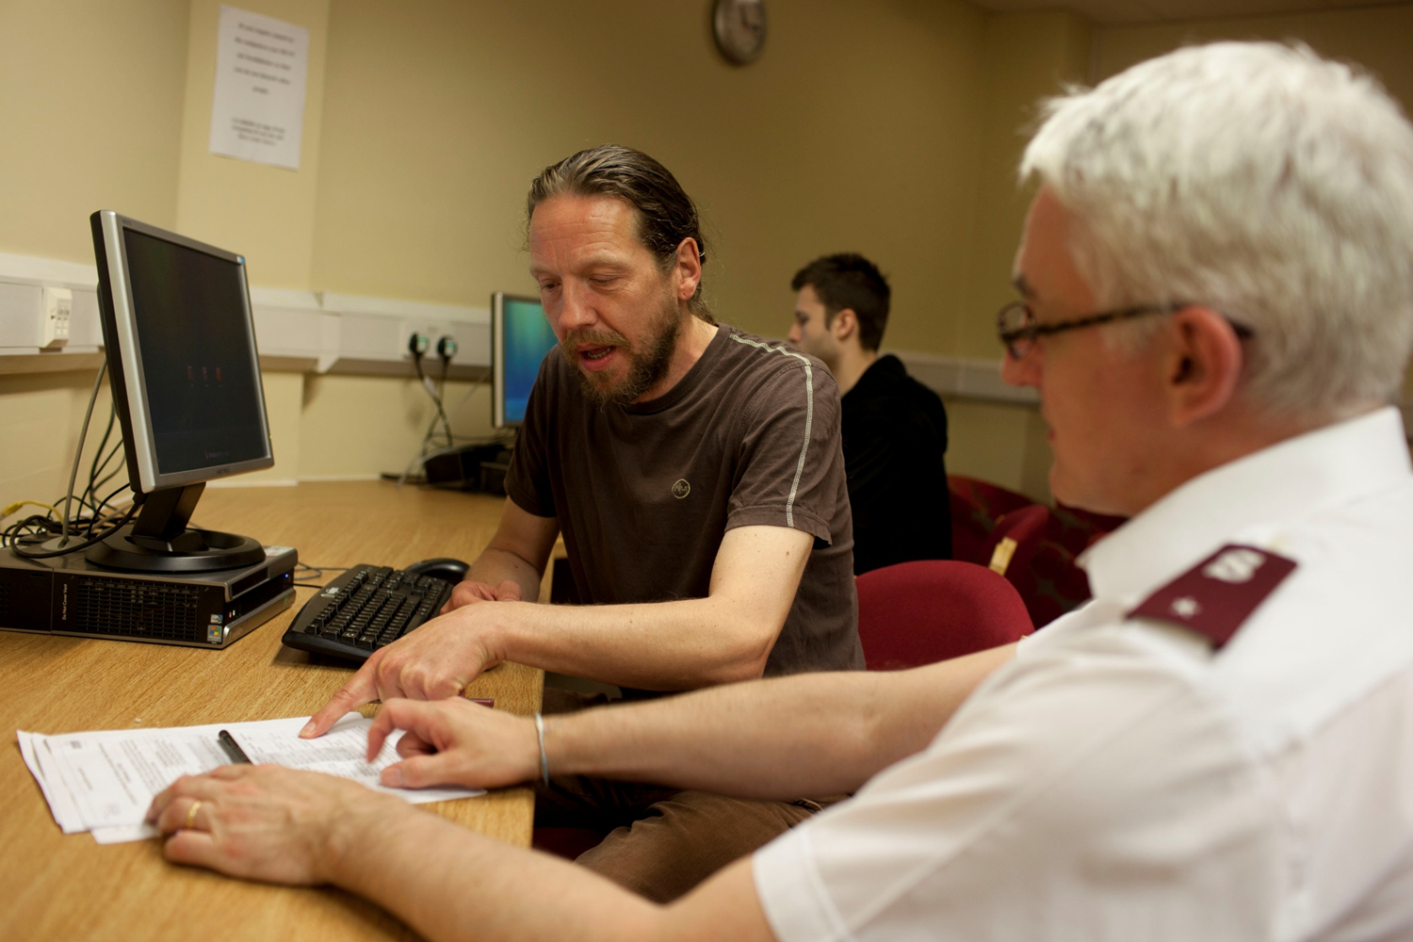

Slide 9
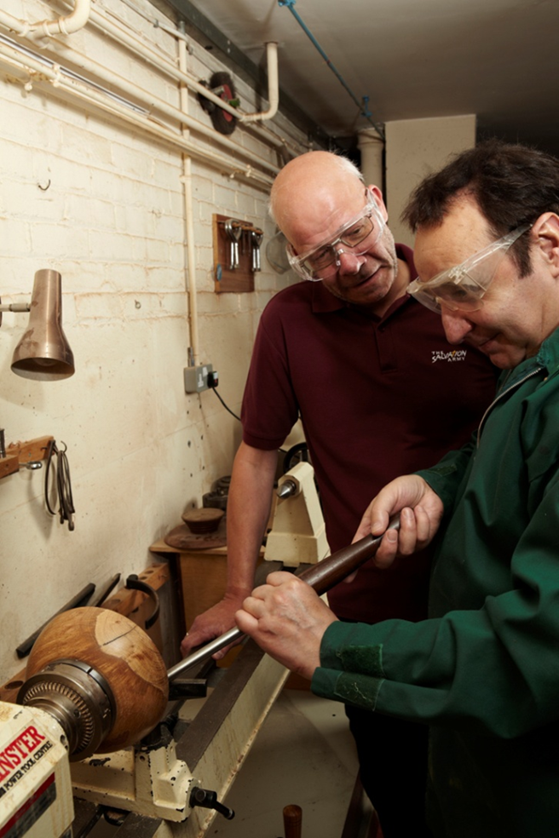
Are you starting to see homelessness a bit differently?

