Slide 1
Notes:
LEADER NOTES: Water scarcity is on the rise. For people all over the world, getting water is daily struggle and climate change is making thing worse.
Today, nearly one-fifth of the world’s population are living in areas of high or extremely high water vulnerability.

Slide 2
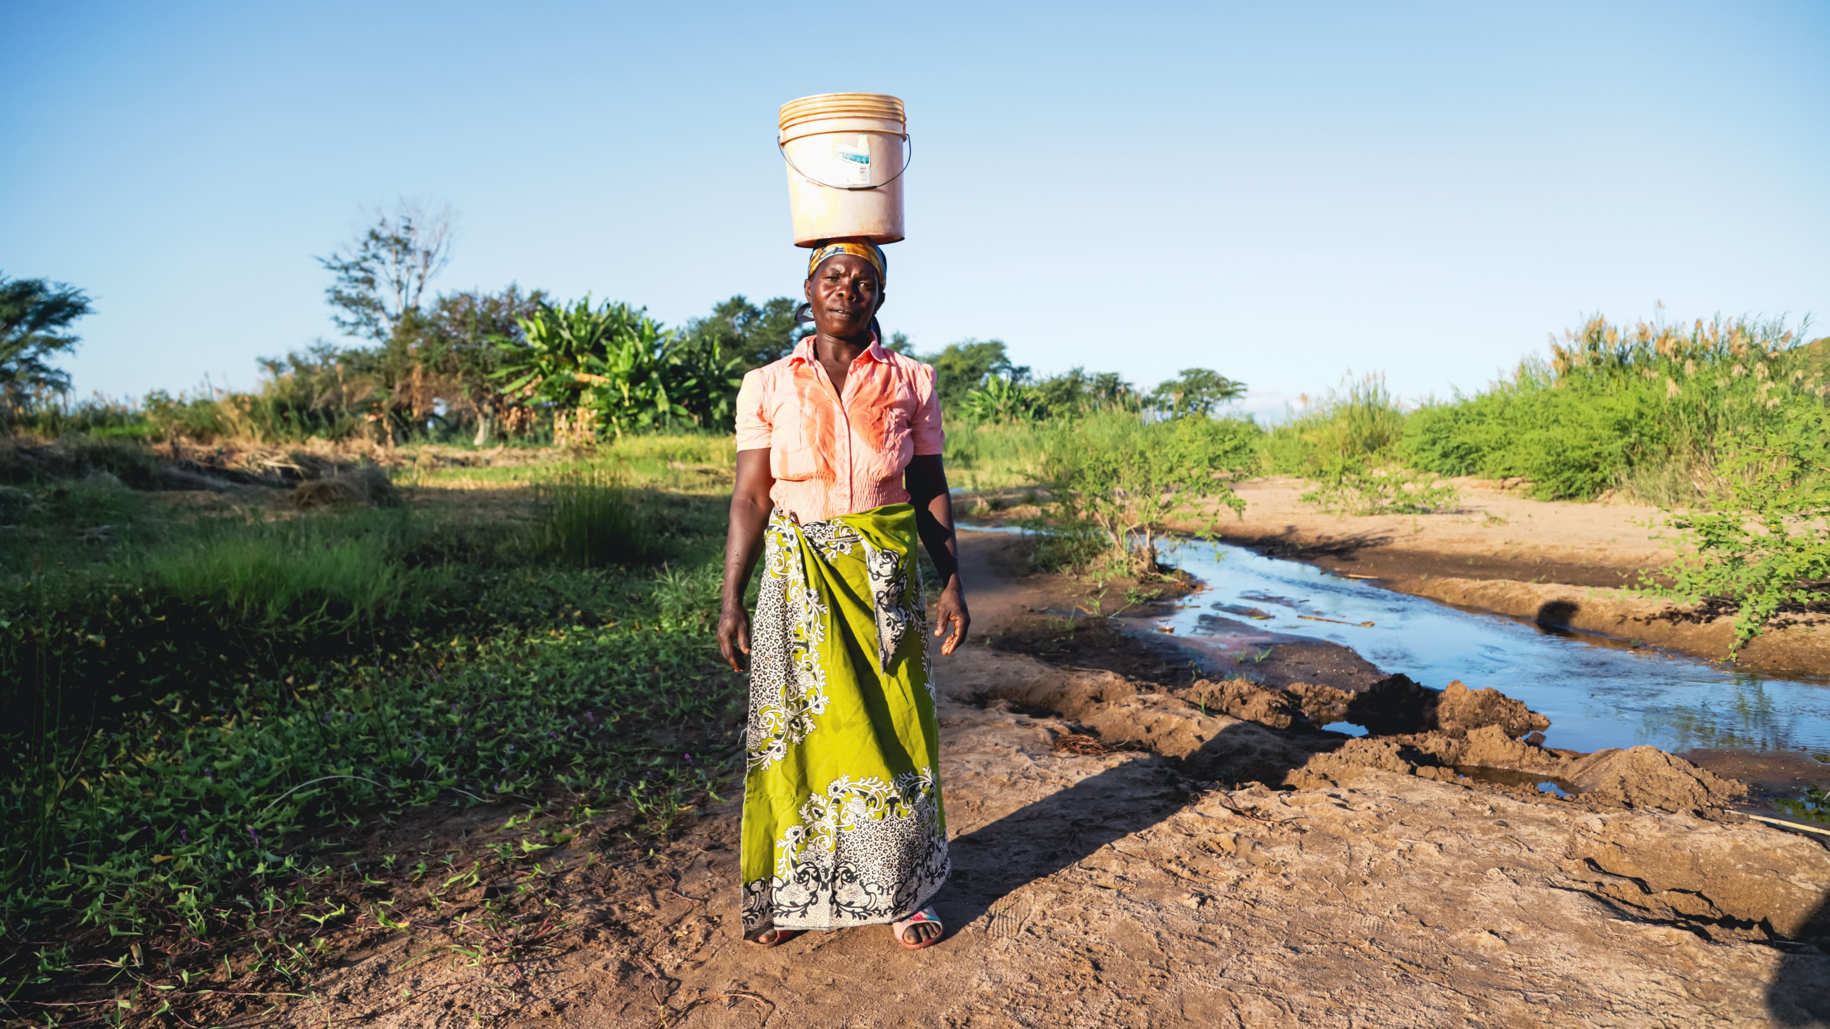
Notes:
In northern Malawi, walking to collect water is a daily chore. It can take hours and the water source is often shared with animals, making it unsafe to drink.
There are other dangers too. On their own, away from the village, many women and girls face the threat of violence and sexual assault.

Slide 3
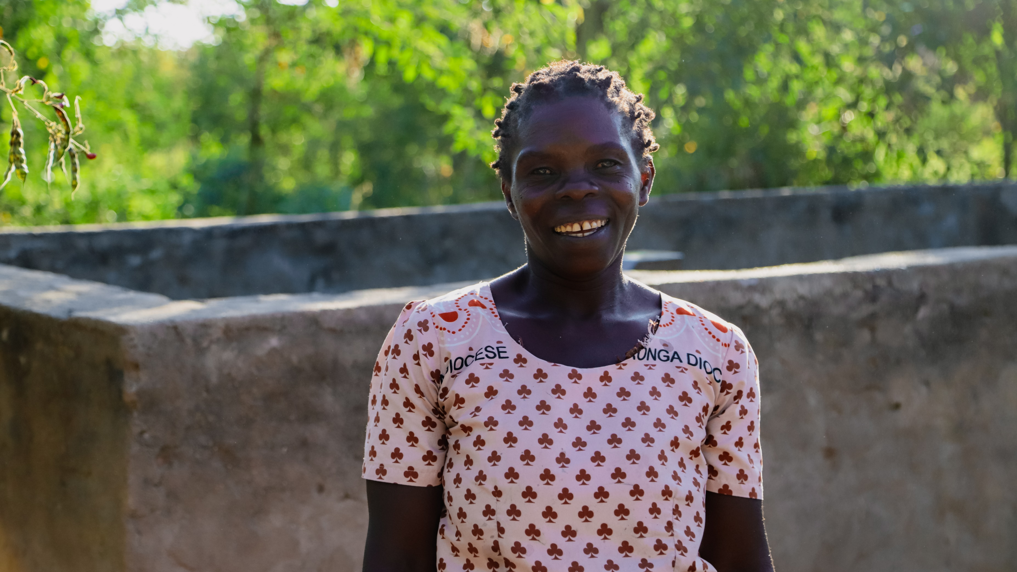
Notes:
As part of a large-scale project in the Karonga district, The Salvation Army in Malawi has worked alongside communities to construct boreholes to improve water access. The water is clean and close by, meaning it is safe for women and girls to collect and use.

Slide 4
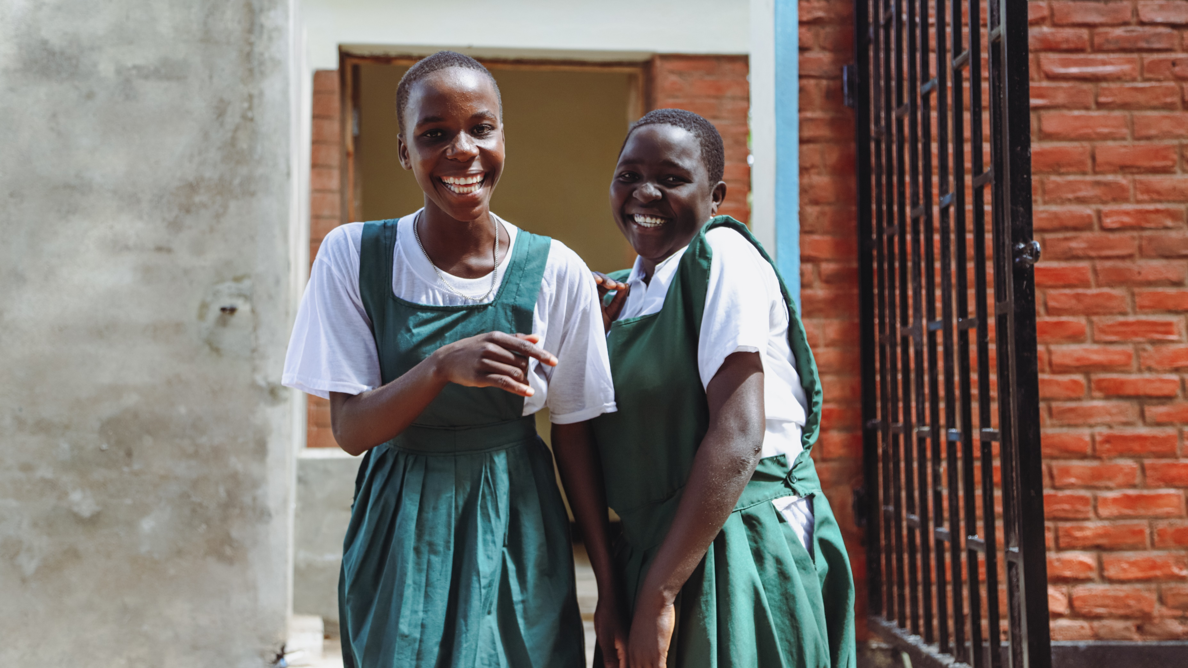
Notes:
Schools are also an important part of the project. New toilet blocks have been built along with improved handwashing facilities. This means girls are less likely to skip school when they get their period, and children are less likely to become ill from unsafe water or unhygienic practices. Now more children can continue their education and reach their potential.

Slide 5
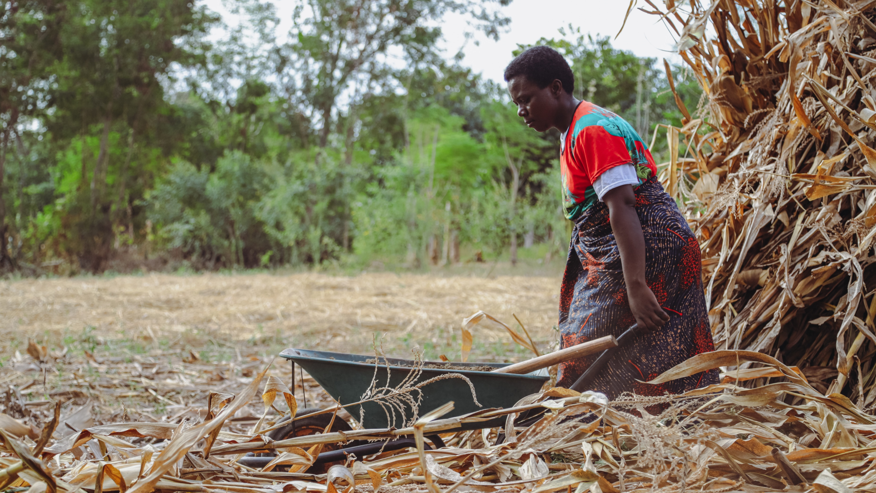
Notes:
There are many elements to this far-reaching, integrated project, which also incorporates agricultural training to enhance people’s food security, and raising awareness about gender equality.
This is just one of the Clean Water projects that The Salvation Army in the United Kingdom and Ireland Territory supports. All money raised through the 2023 Helping-Hand Appeal will go towards supporting future Clean Water projects.

Slide 6
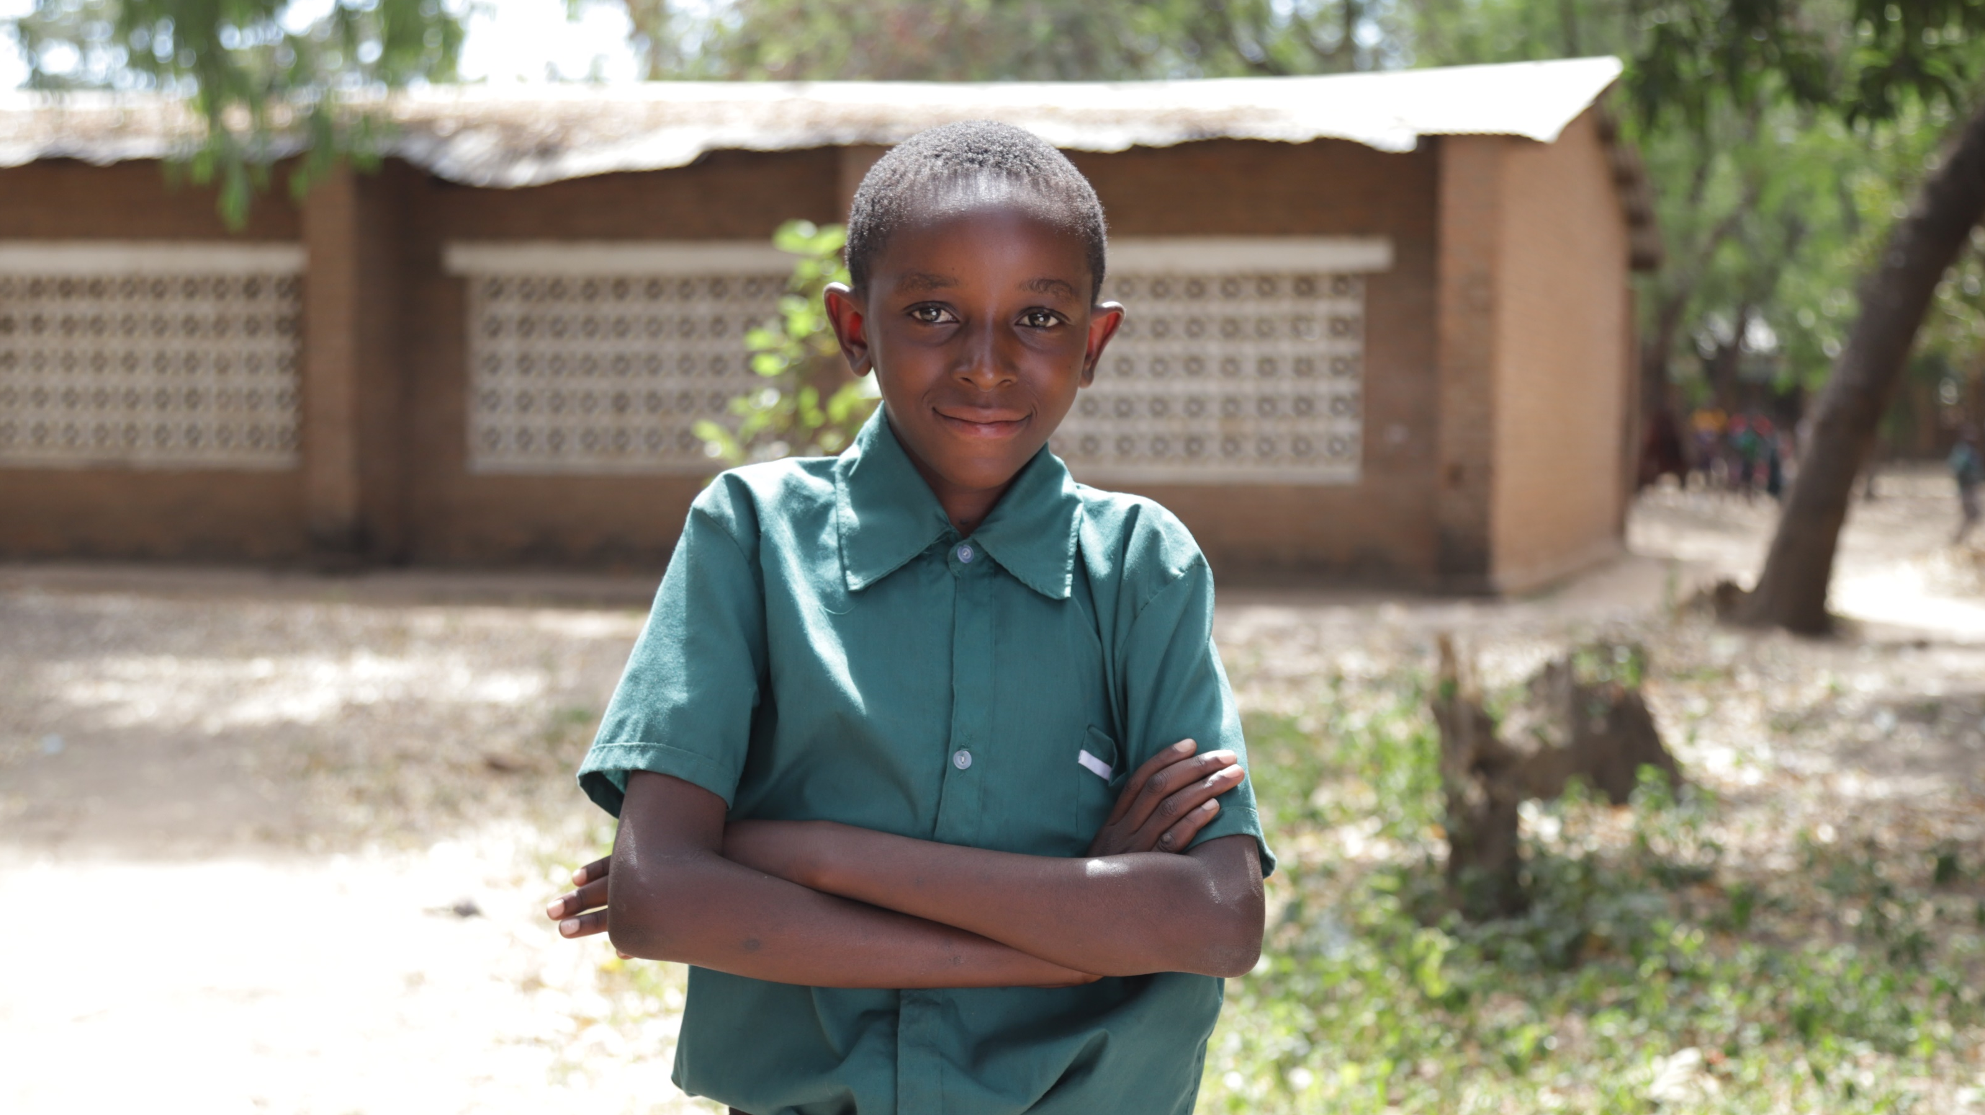
Notes:
Water is more than a drink...
It is children thriving. It is continued education. It is time to build your business. It is the potential for equal opportunities. It is economic independence.
Water is life!

Slide 7
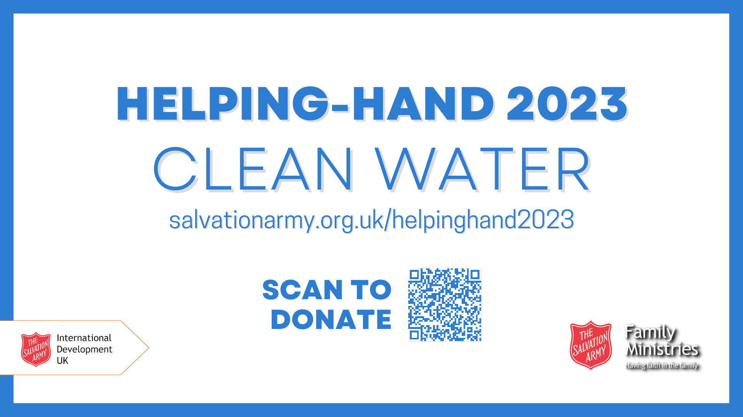
Notes:
If you would like to support the Helping-Hand Appeal, please make a donation:
Online at www.salvationarmyorg.uk/helpinghand2023
By scanning the QR code
By giving cash to your local Salvation Army corps

