Slide 1
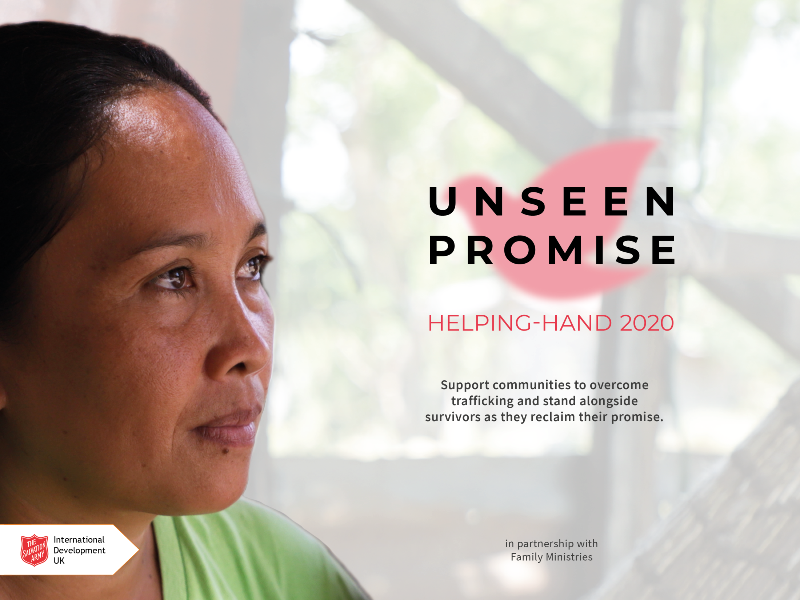
Notes:
[Speaker notes begin on next slide]

Slide 2
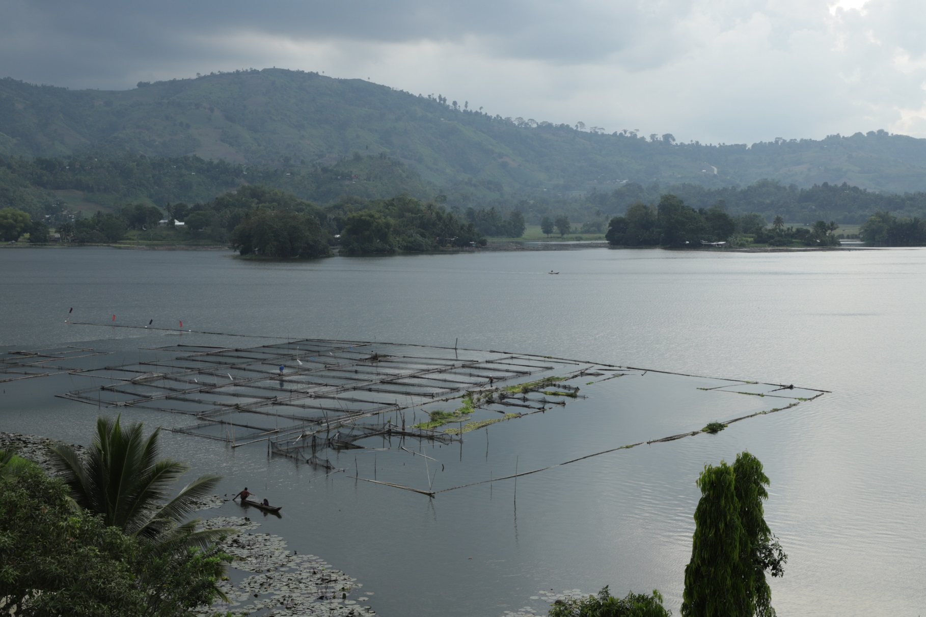
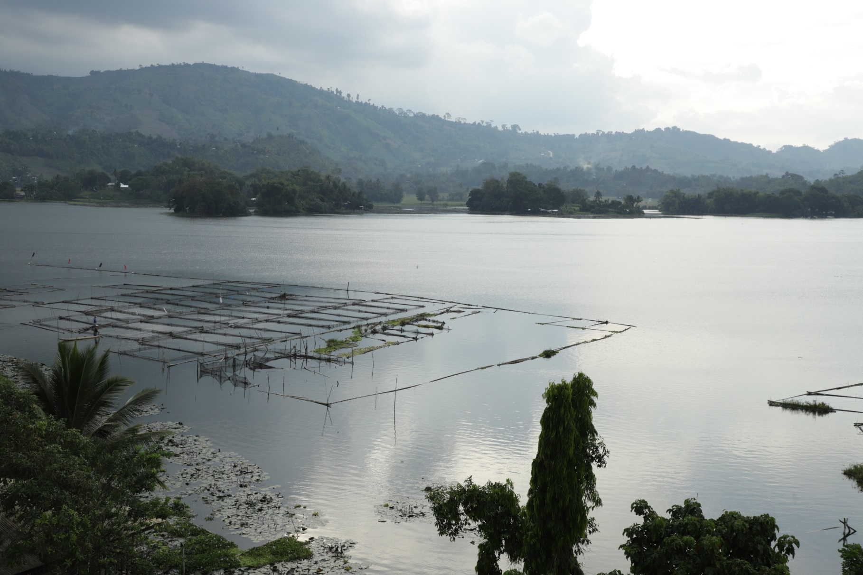
Notes:
The promise of a better life is a tempting offer.
For those living in poverty, in even the most beautiful parts of the world, the dream of providing for your family becomes a constant and agonising ache.

Slide 3
Notes:
In the Philippines – a sun-kissed paradise of more than 7,000 tropical islands – one in five people live in poverty and the luscious setting shrouds an ugliness which lies beneath the surface.
Preying on the vulnerable, traffickers deceive and exploit, enticing people with the promise of dreams fulfilled.

Slide 4
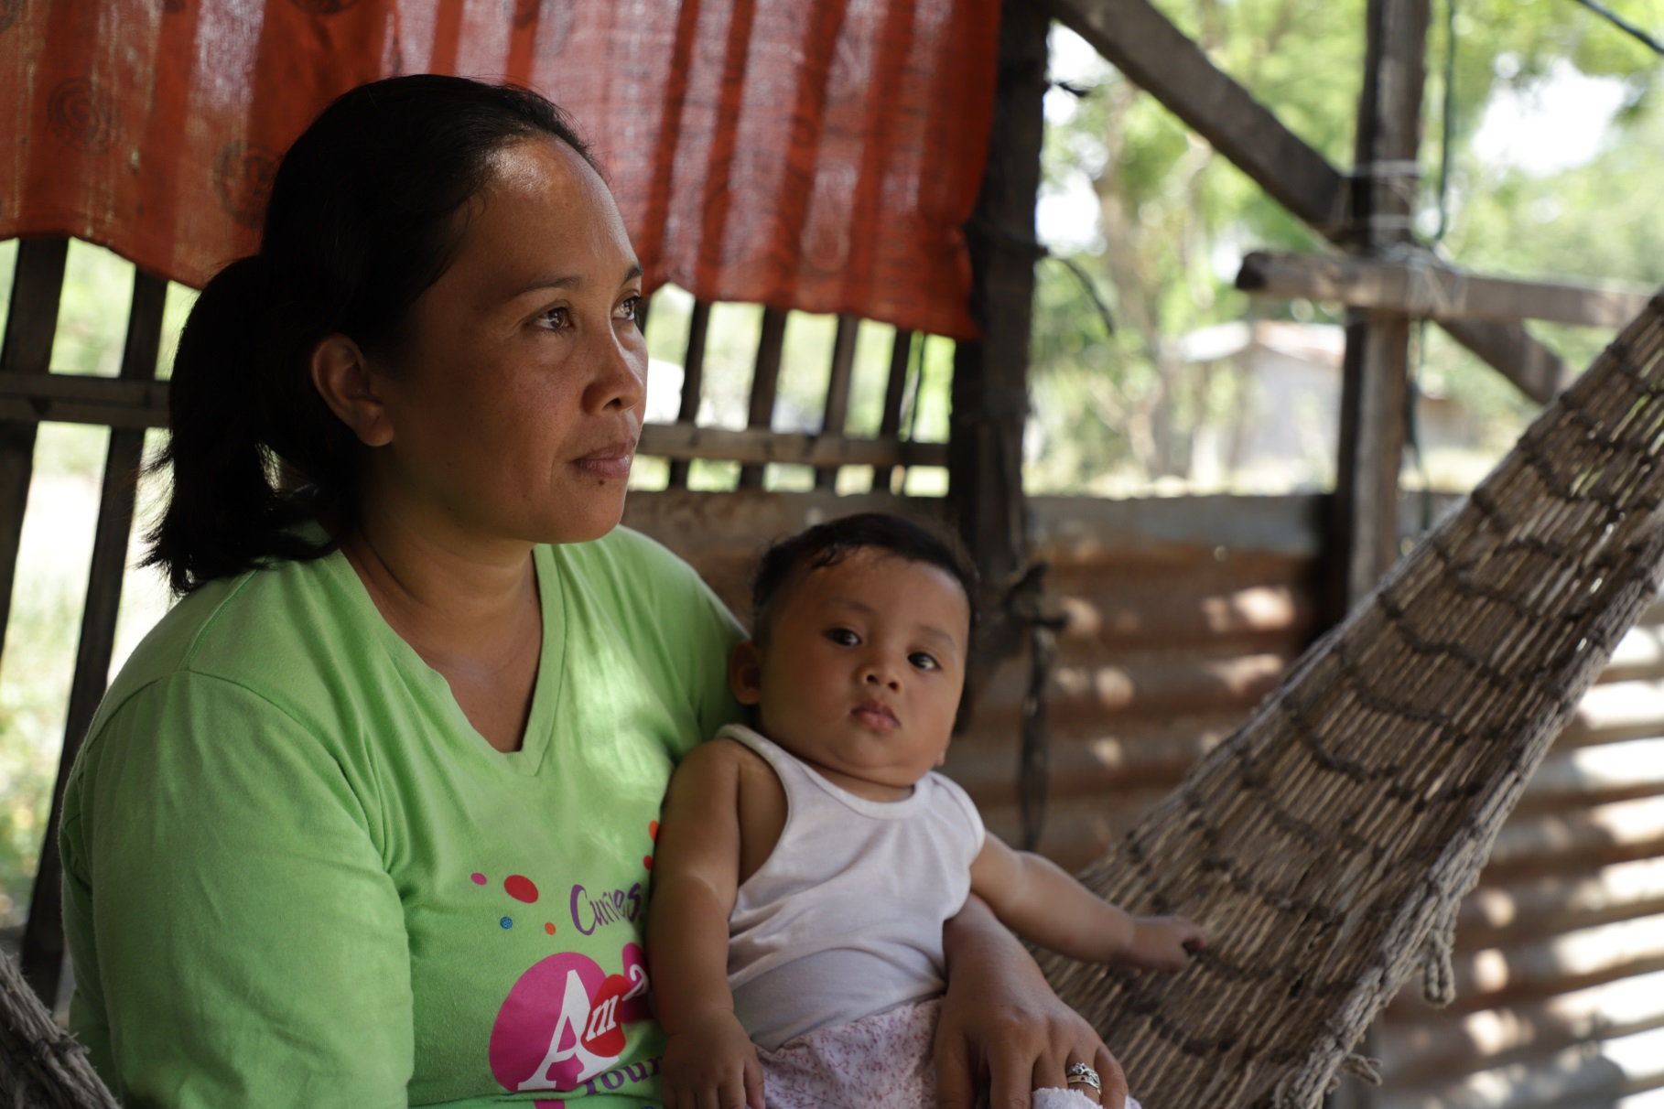
Notes:
People who are desperate to support those they love, believe the lies and accept opportunities to journey away from home unaware of the reality which awaits them.
The promises remain unseen and the dreams remain unrealised.

Slide 5
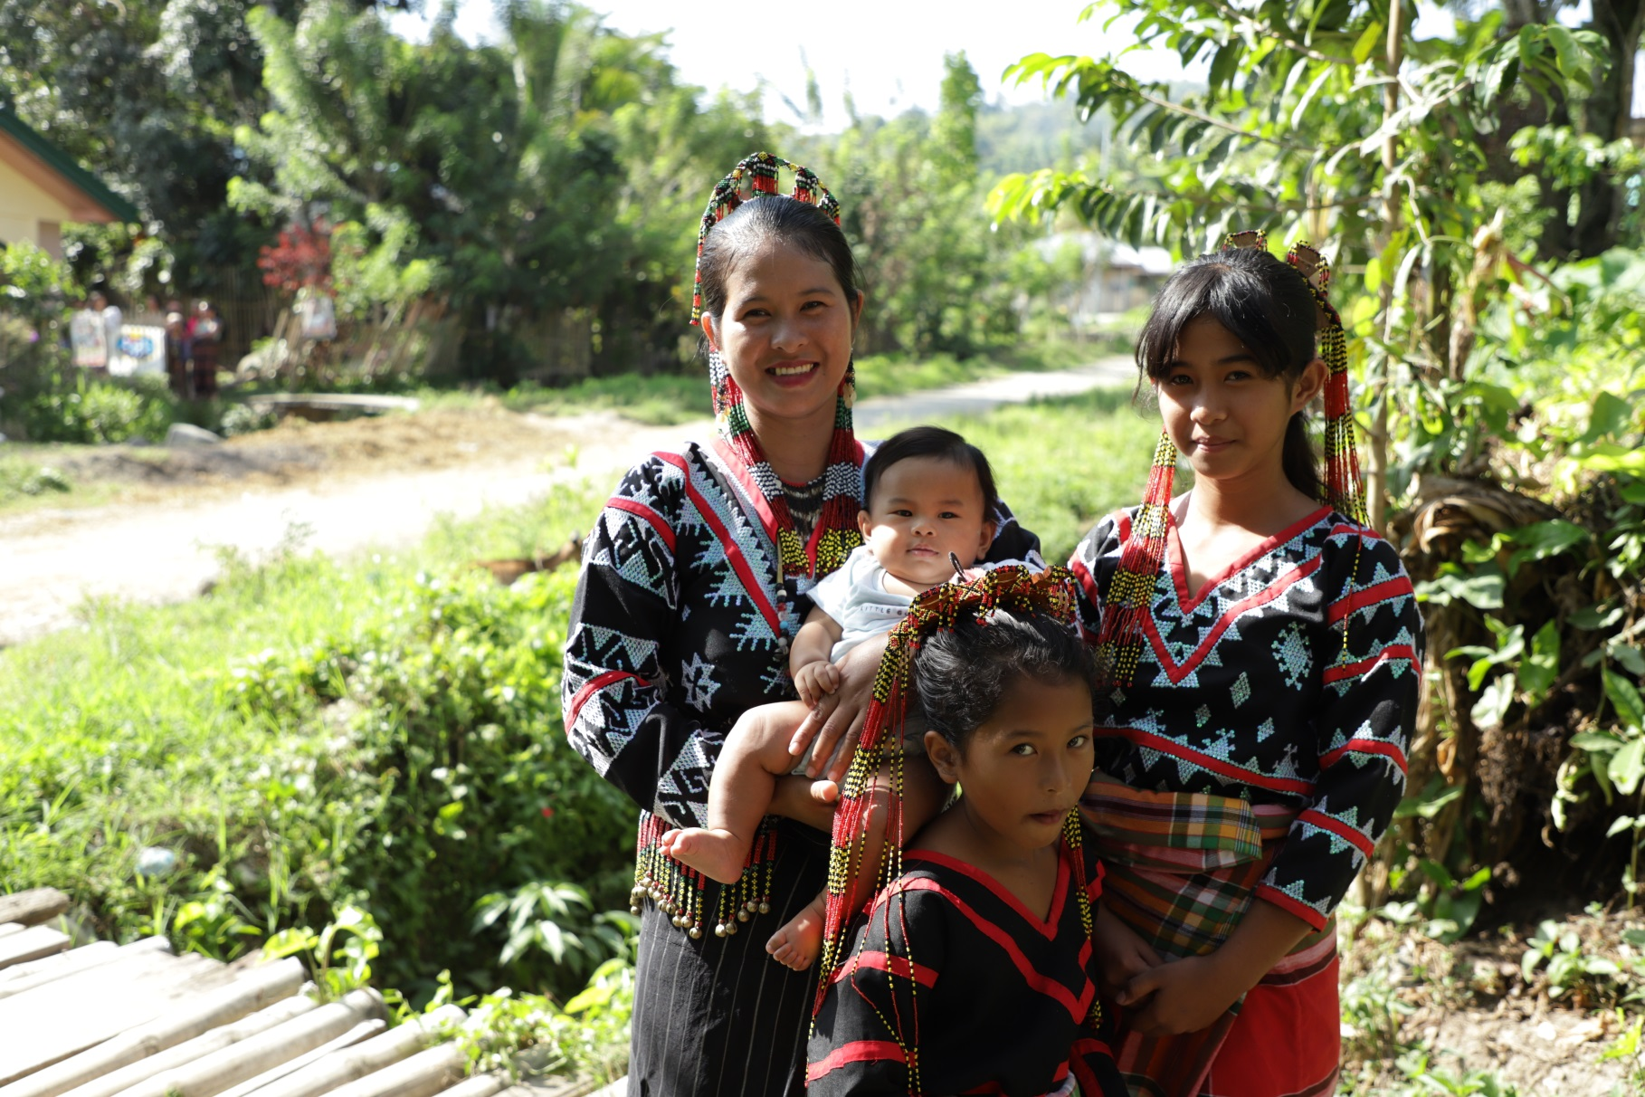
Notes:
Traffickers see people merely as commodities, ignoring the truth of who they are – children of God, full of promise and dearly loved by the One who created them.

Slide 6
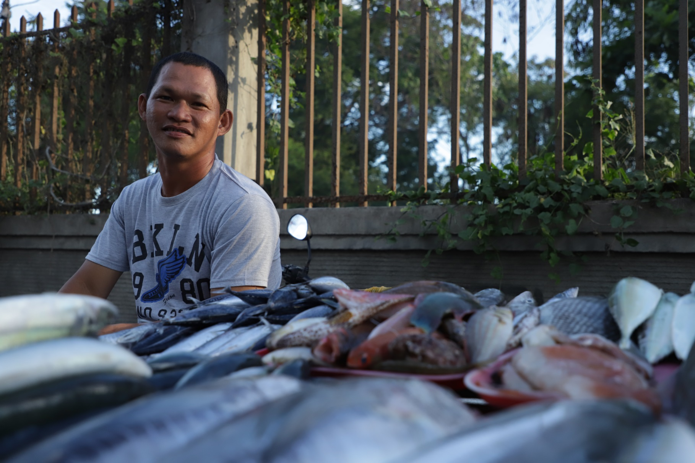
Notes:
The Salvation Army is raising awareness of the reality of trafficking, mobilising communities to protect themselves, supporting survivors and helping to improve opportunities at home so the drive to leave is lessened.

Slide 7
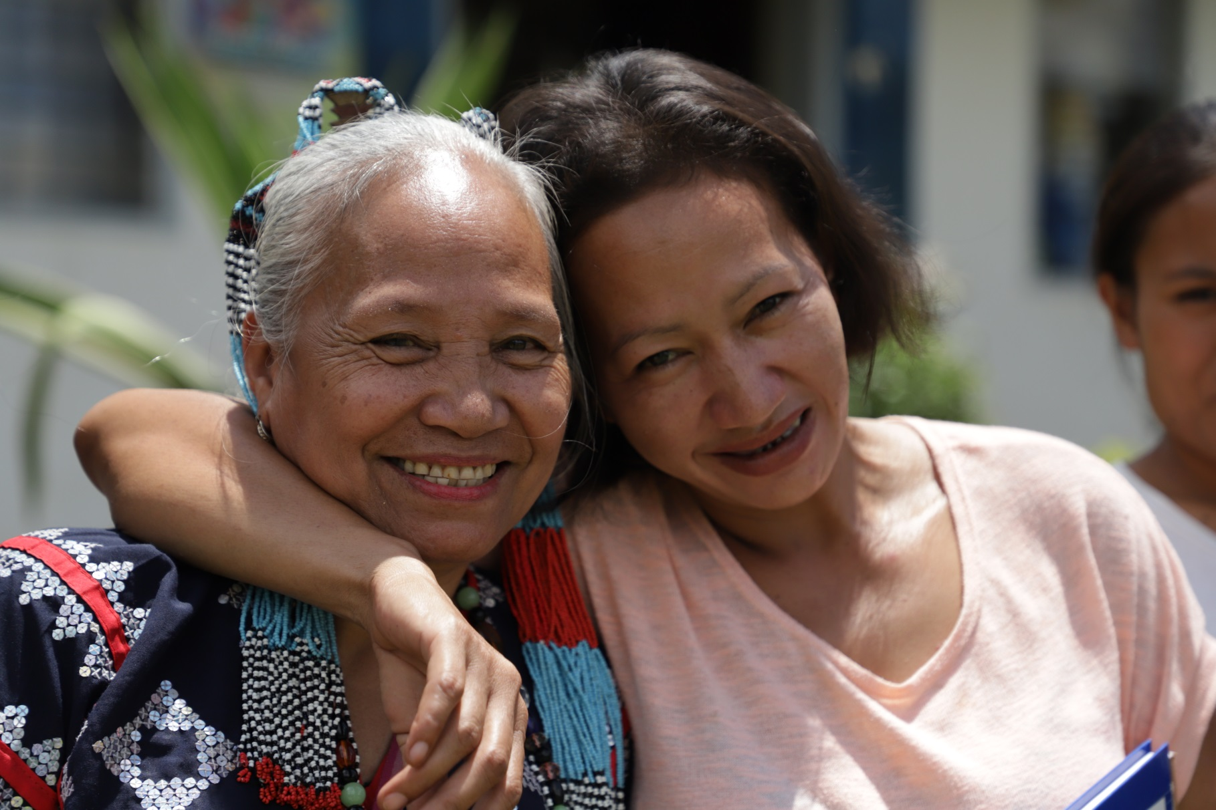
Notes:
Through prevention, protection and partnership, we are supporting people to reclaim the promise that exists within them and rebuild their lives.

Slide 8
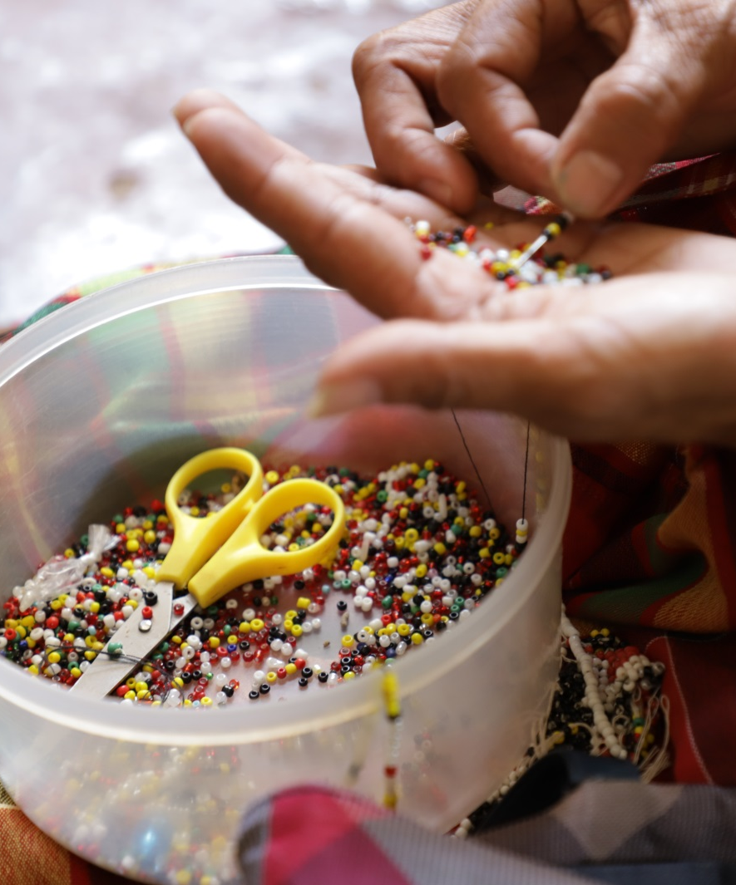
Pray
Fundraise together
Make a donation
Notes:
We can help by:
Praying: We can make a difference by praying for people that The Salvation Army is working alongside – that the evil of human trafficking will be stopped and that survivors will be given support and opportunity to heal, recover and flourish.
Fundraising together: Whether we contribute small amounts each week or hold events in our community, we can find fun and interesting ways to raise money for Helping-Hand 2020.
Making a personal donation: If you would like to donate, you can give the money to your group or corps leader, or donate online at donate.salvationarmy.org.uk/anti-trafficking/

Slide 9
£10 could mobilise a community to protect themselves and each other from trafficking
£40 could pay for a seminar which empowers women to find their worth and realise their potential
£76 could provide accommodation, medical care and living costs to a survivor of trafficking
Notes:
Together, we can bring the injustice of human trafficking to an end. We can stand alongside survivors as they reclaim the promise that exists within them and rebuild their lives. These are just some examples of how our donations could support The Salvation Army’s anti-trafficking work around the world.

Slide 10
salvationarmyid
salvationarmyid
salvationarmyid
thesalvationarmyid
#unseenpromise
Notes:
If you want to connect with The Salvation Army International Development UK on social media you can find them on Facebook, YouTube, Twitter and Instagram. Follow them to hear about new campaigns and updates from their projects.

