Slide 1
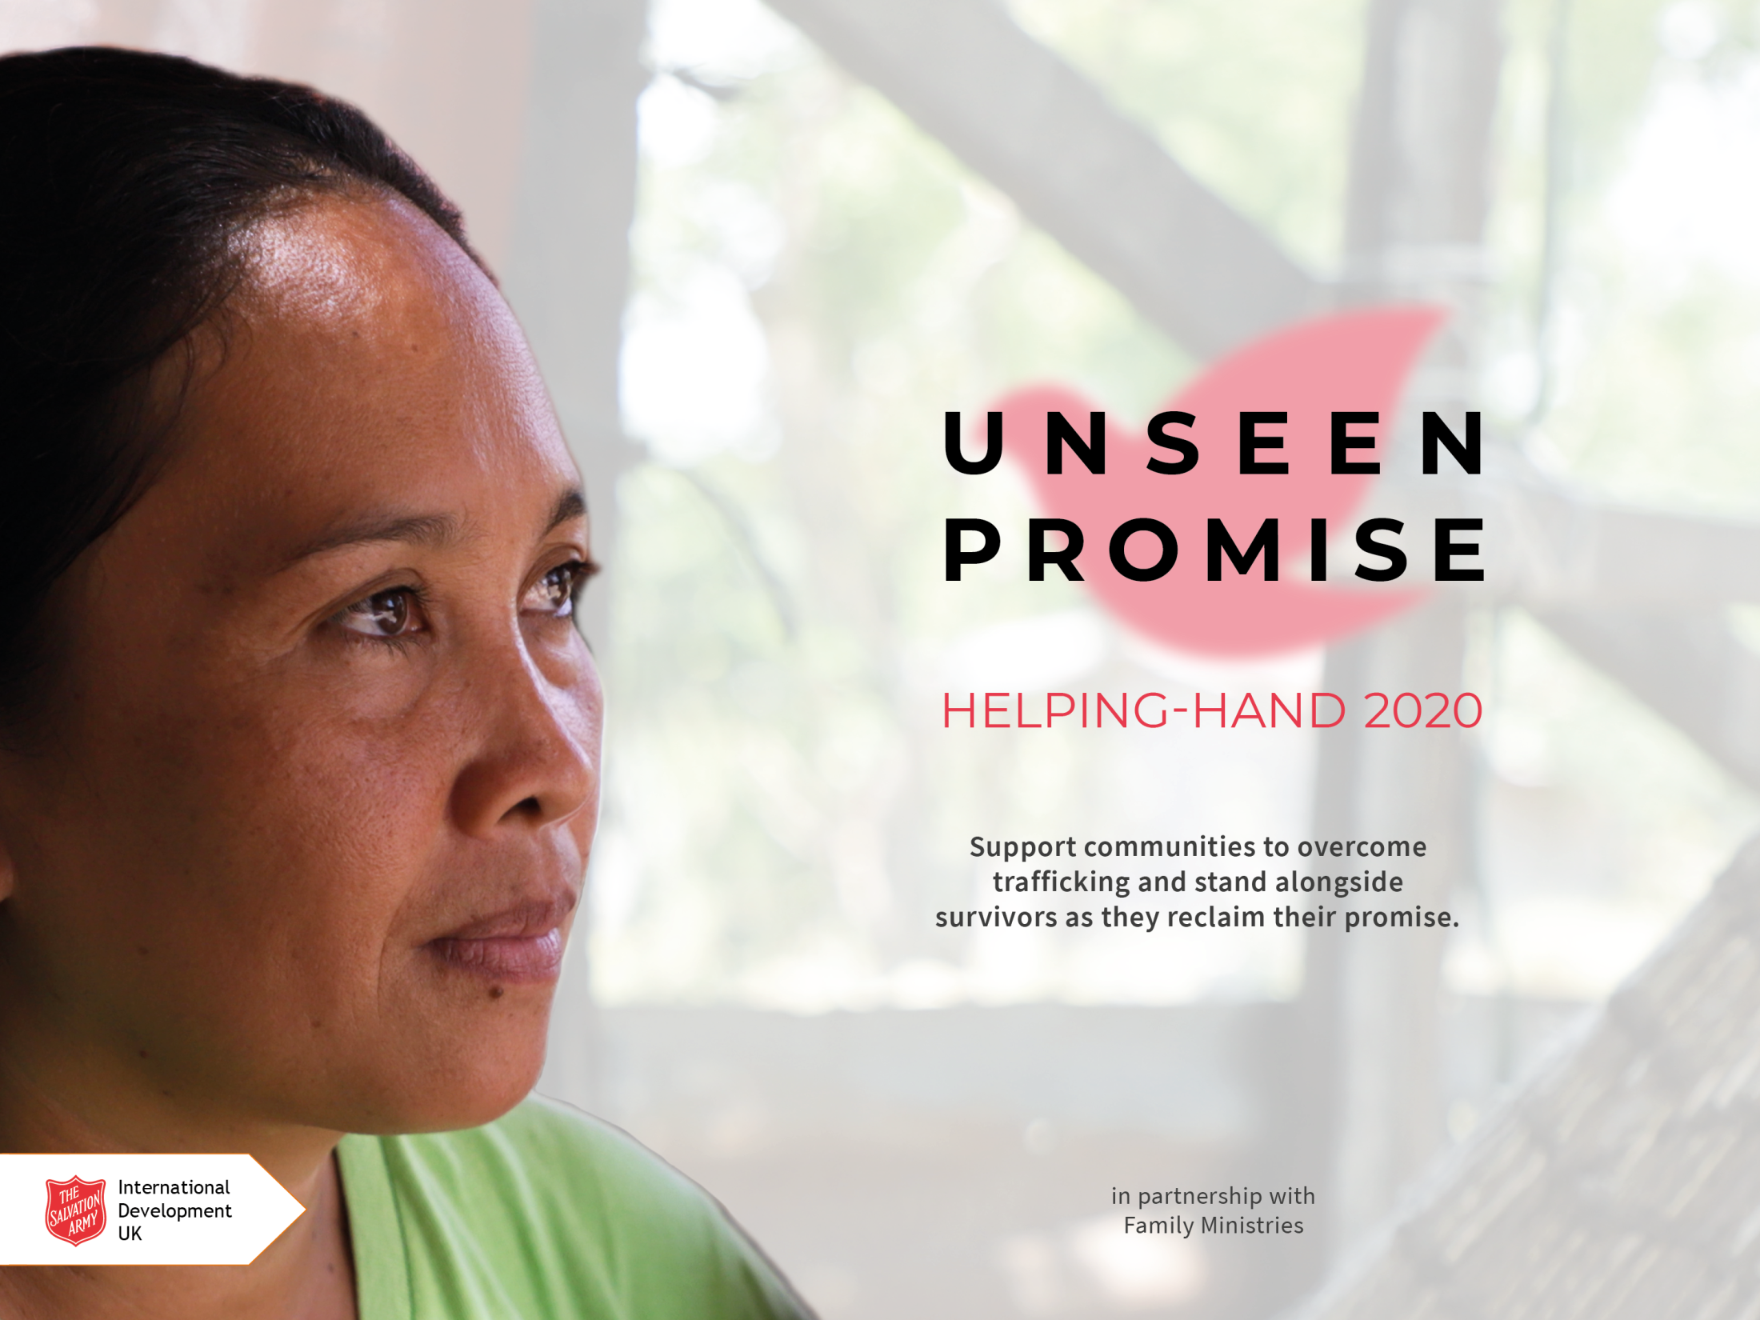

Slide 2
Notes:
Introduction video – Unseen Promise

Slide 3
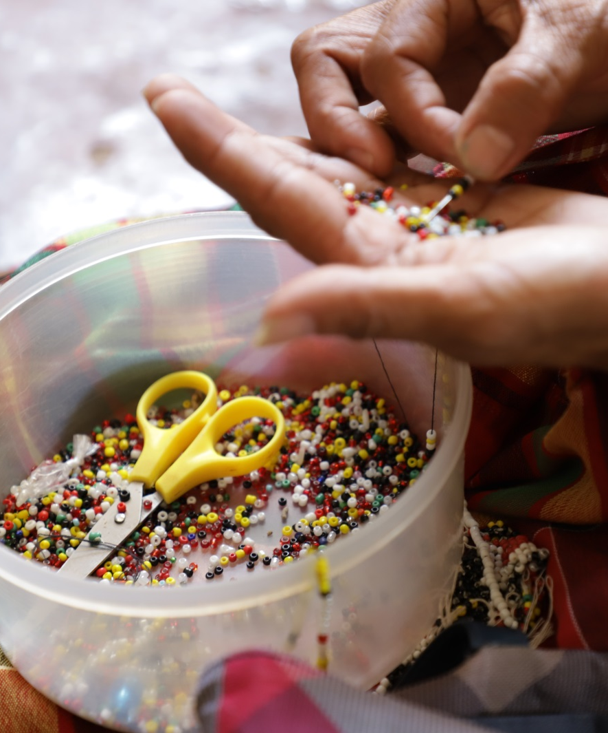
Pray
Fundraise together
Make a donation
Notes:
We can help by:
Praying: We can make a difference by praying for people that The Salvation Army is working alongside – that the evil of human trafficking will be stopped and that survivors will be given support and opportunity to heal, recover and flourish.
Fundraising together: Whether we contribute small amounts each week or hold events in our community, we can find fun and interesting ways to raise money for Helping-Hand 2020.
Making a personal donation: If you would like to donate, you can give the money to your group or corps leader, or donate online at donate.salvationarmy.org.uk/anti-trafficking/

Slide 4
£10 could mobilise a community to protect themselves and each other from trafficking
£40 could pay for a seminar which empowers women to find their worth and realise their potential
£76 could provide accommodation, medical care and living costs to a survivor of trafficking
Notes:
Together, we can bring the injustice of human trafficking to an end. We can stand alongside survivors as they reclaim the promise that exists within them and rebuild their lives. These are just some examples of how our donations could support The Salvation Army’s anti-trafficking work around the world.

Slide 5
Notes:
If you have time during your meeting, also show one (or more) of the case story videos. Available to watch on YouTube or download from Vimeo:
Mercy’s Story
YouTube (watch online) - https://youtu.be/PXvvYzRAlrA
Vimeo (download) - https://vimeo.com/362017746 /
Cecilia’s Story
YouTube (watch online) - https://youtu.be/fBHs8gMt6D0
Vimeo (download) - https://vimeo.com/362017576
Tulon Self-Help Group
YouTube (watch online) - https://youtu.be/f6z7K6-JMi8
Vimeo (download) - https://vimeo.com/362018077

Slide 6
salvationarmyid
salvationarmyid
salvationarmyid
thesalvationarmyid
#unseenpromise
Notes:
If you want to connect with The Salvation Army International Development UK on social media you can find them on Facebook, YouTube, Twitter and Instagram. Follow them to hear about new campaigns and updates from their projects.

