Slide 1
Team Challenge
www.salvationarmy.org.uk/schools

Slide 2
How many do you take?

Slide 3
How many do you take?

Slide 4
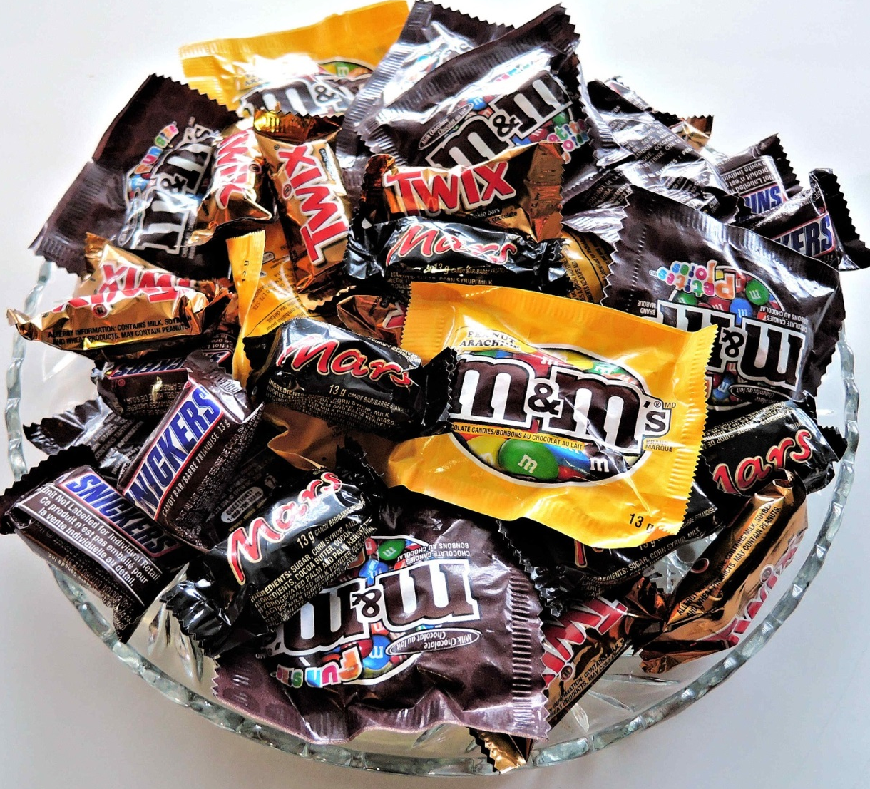
How many do you take?

Slide 5
Thank
you

Slide 7
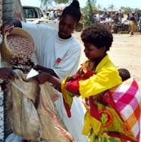
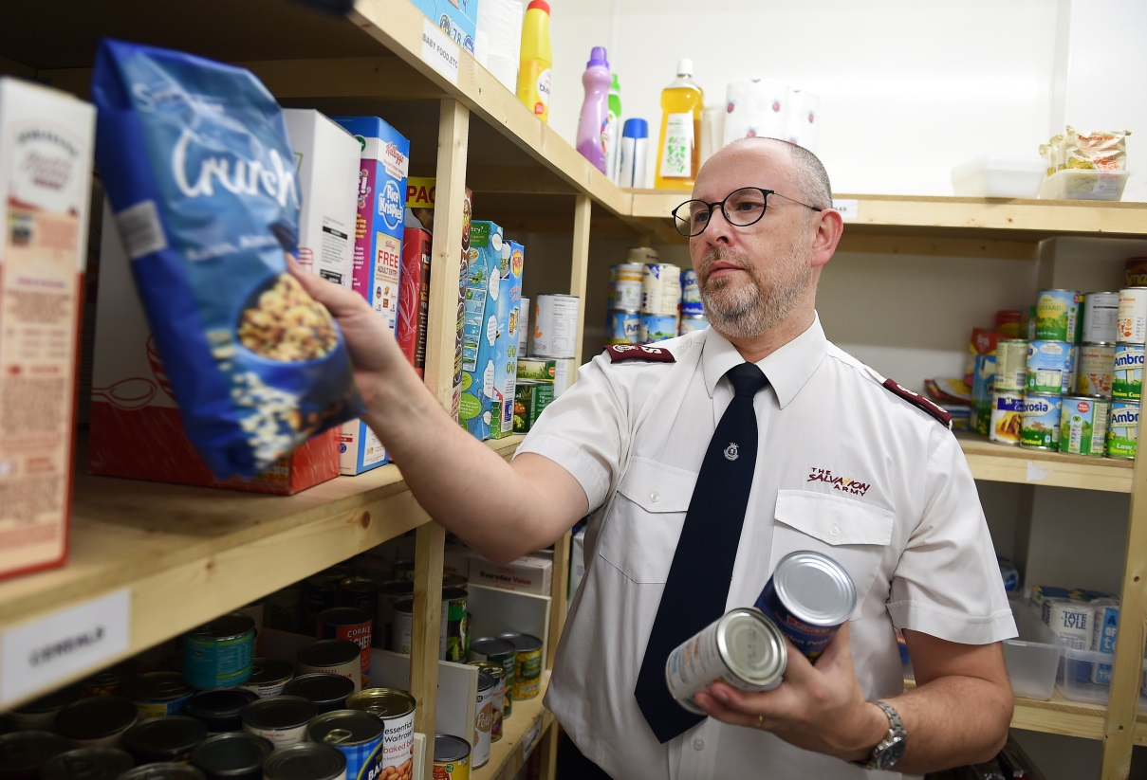

Slide 8
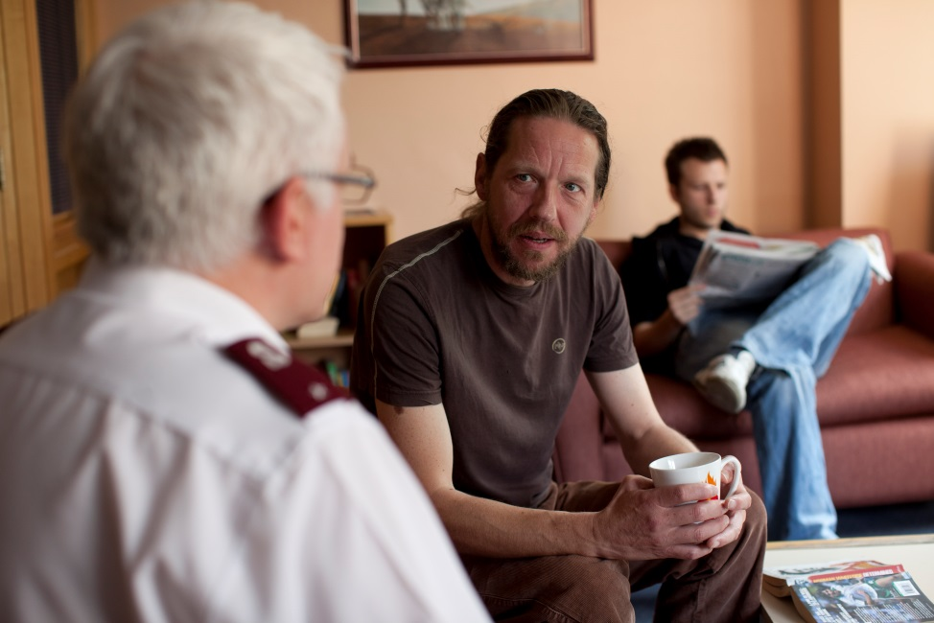
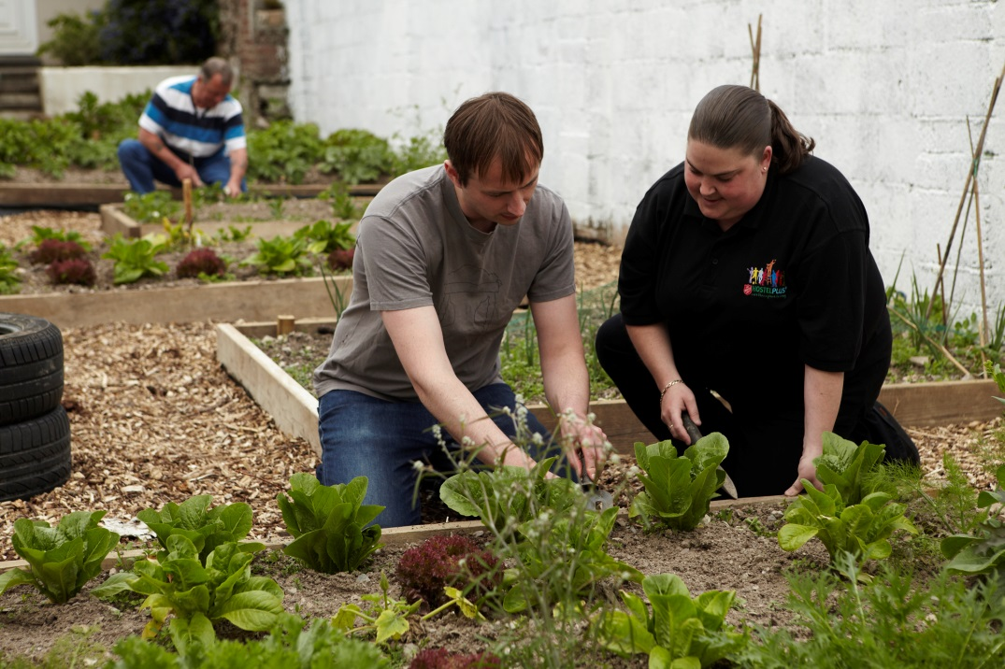

Slide 9
How do you share?

Slide 10
www.salvationarmy.org.uk/schools

