Slide 1

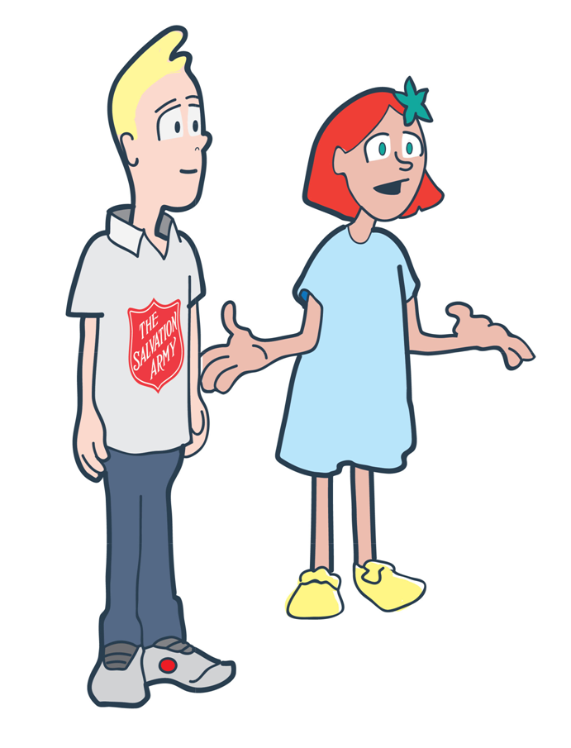
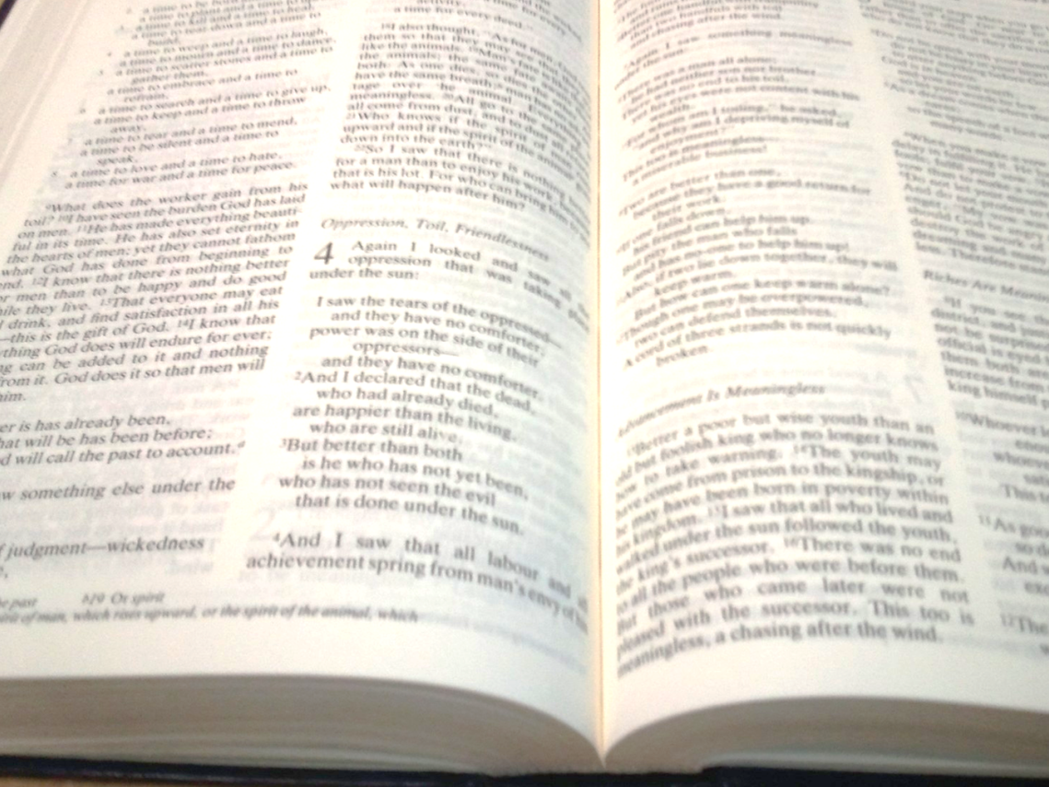

Slide 2


Why is the Bible important to The Salvation Army?

Slide 3


Lesson
Outcomes
To understand why the Bible is
important to Salvation
Army members
To be able to explain one
Bible teaching and what it means
To be able to reflect on whether
you agree with a number of
Bible teachings and explain
your opinion on them.

Slide 4
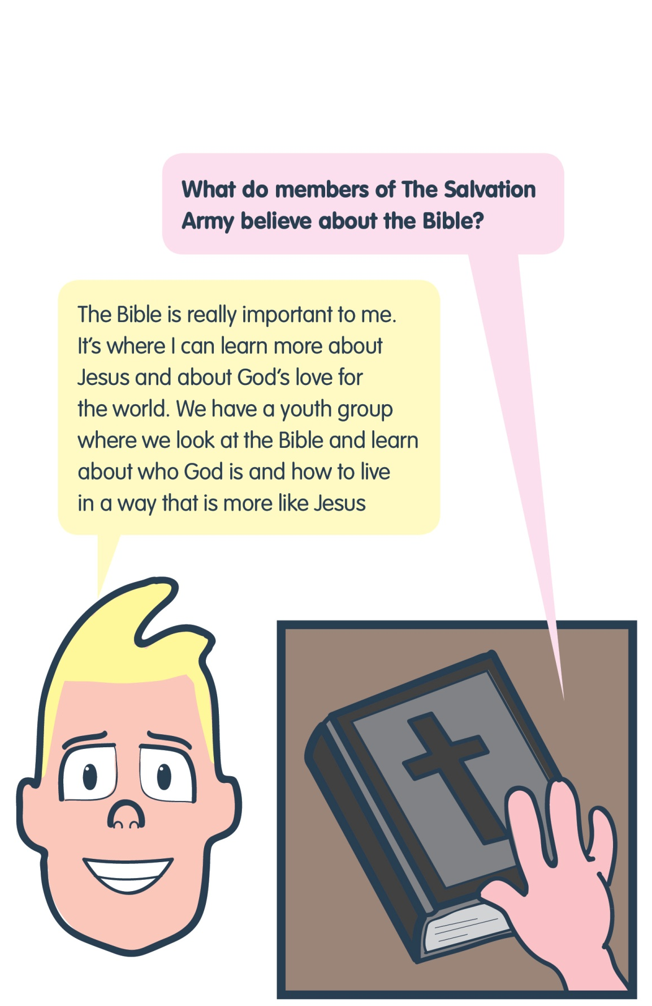
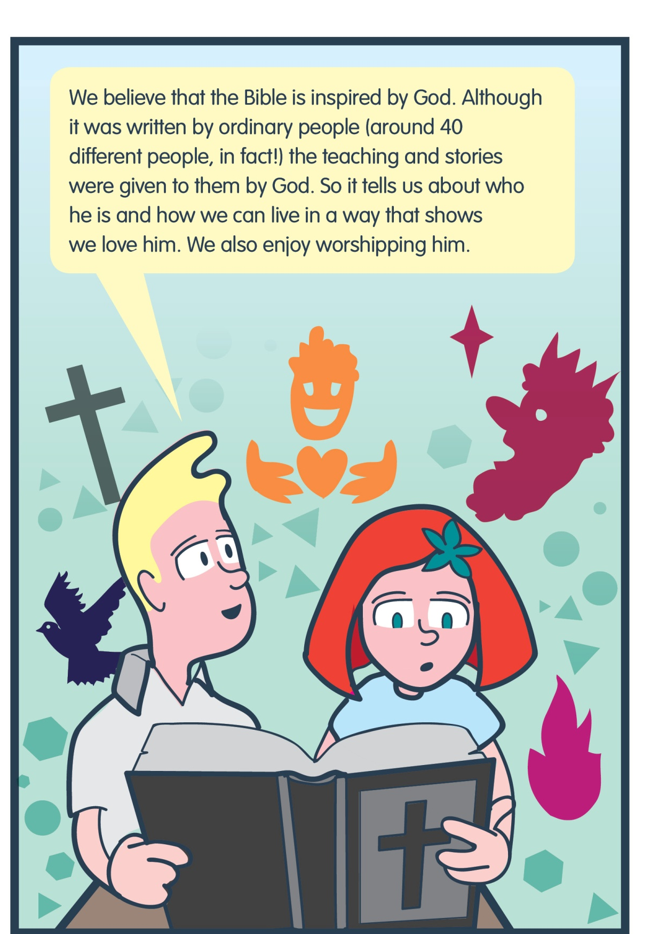
Name one thing Salvation Army members believe about the Bible
Name one reason the Bible is important to Salvation Army members

Slide 5



Read your teaching and explain to your partner what you think it means and whether you agree with it. Ask them what they think about it!

Slide 6
Lesson
Outcomes
To understand why the Bible is
important to Salvation
Army members
To be able to explain one
Bible teaching and what it means
To be able to reflect on whether
you agree with a number of
Bible teachings and explain
your opinion on them.

Slide 7

Agree
Unsure
Disagree
What do you think?

Slide 8
40
Youth group
Jesus
Love one another
The Bible
God’s love
The Salvation Army
Teachings and stories
Corps

Slide 9


Plenary
To understand why the Bible is
important to Salvation
Army members
To be able to explain one
Bible teaching and what it means
To be able to reflect on whether
you agree with a number of
Bible teachings and explain
your opinion on them.

