Slide 2
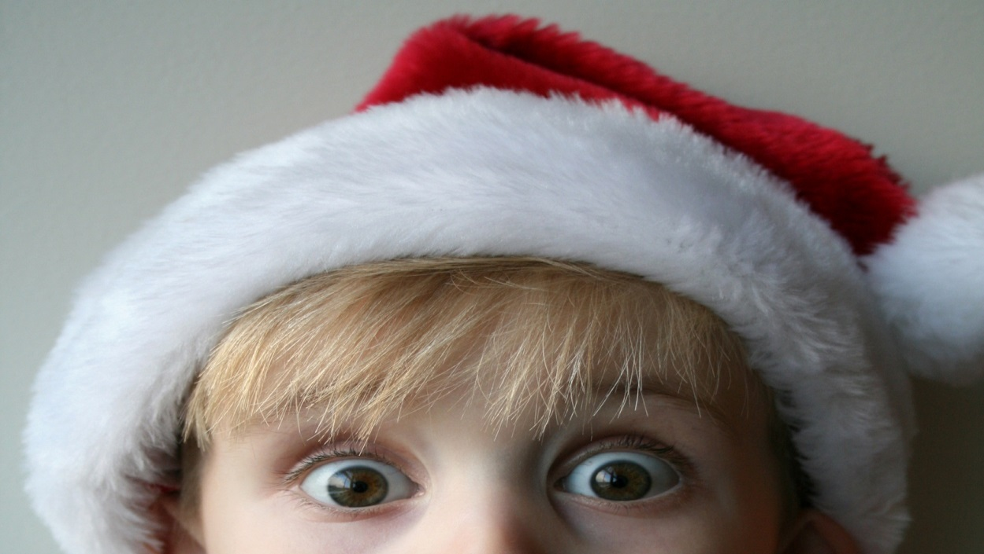



How do you know it is Christmas?

Slide 3

What makes a tree a Christmas tree?

Slide 4
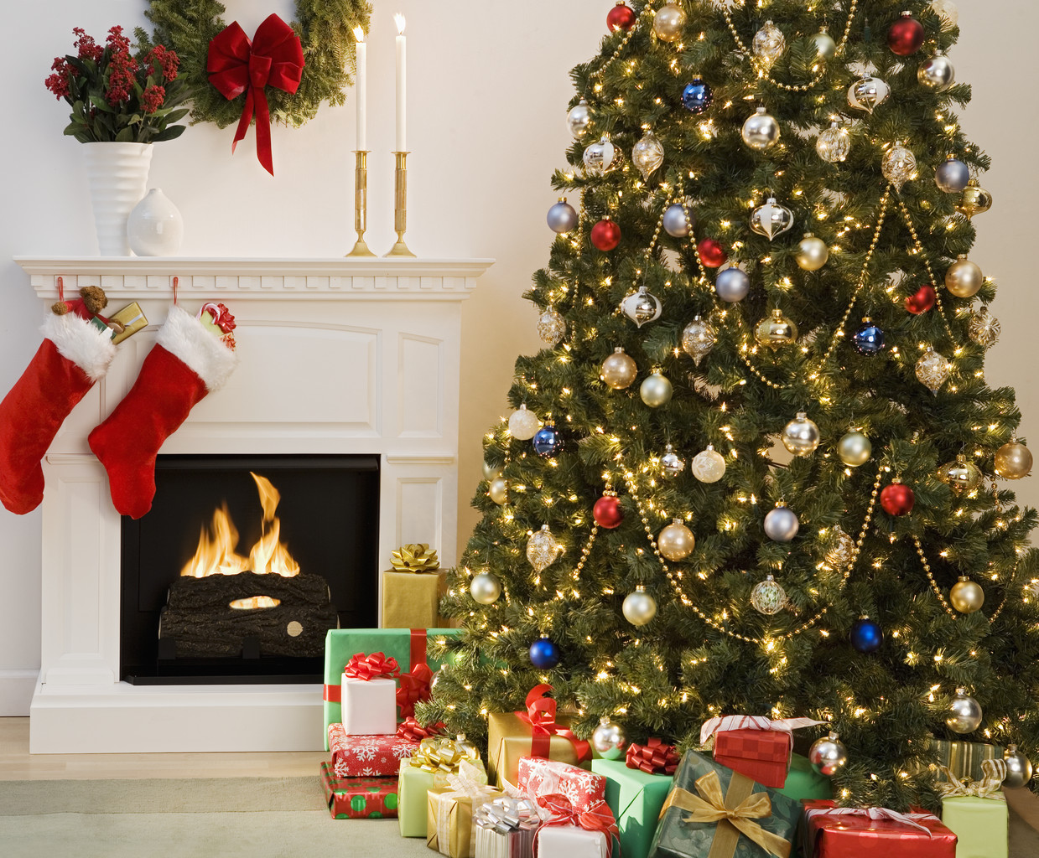
Why do we want presents under the tree?

Slide 5
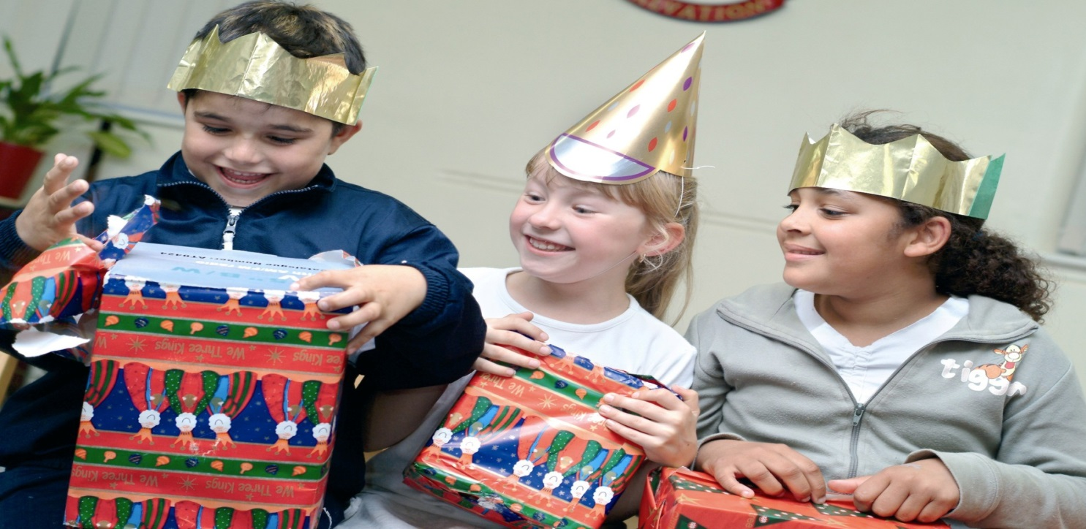
Have you ever wished for a present?

Slide 6
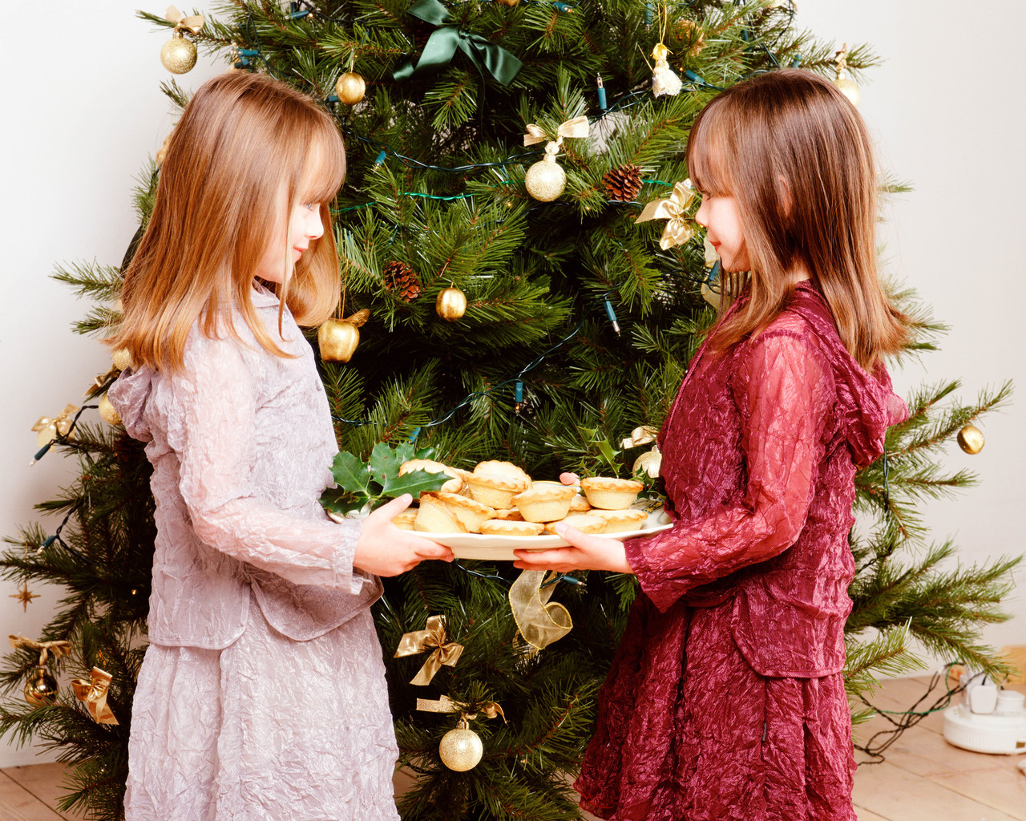

What does it feel like to give a gift?

Slide 7
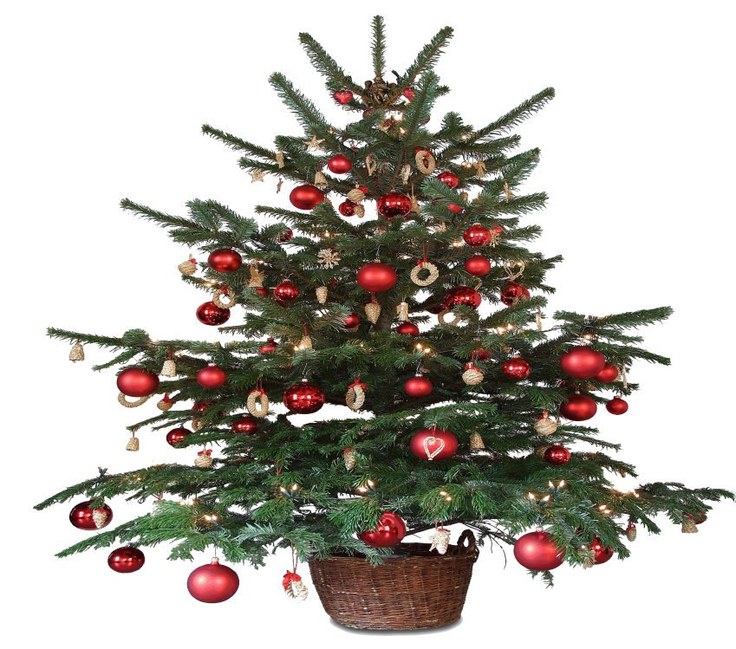
A tree with no presents.

Slide 8

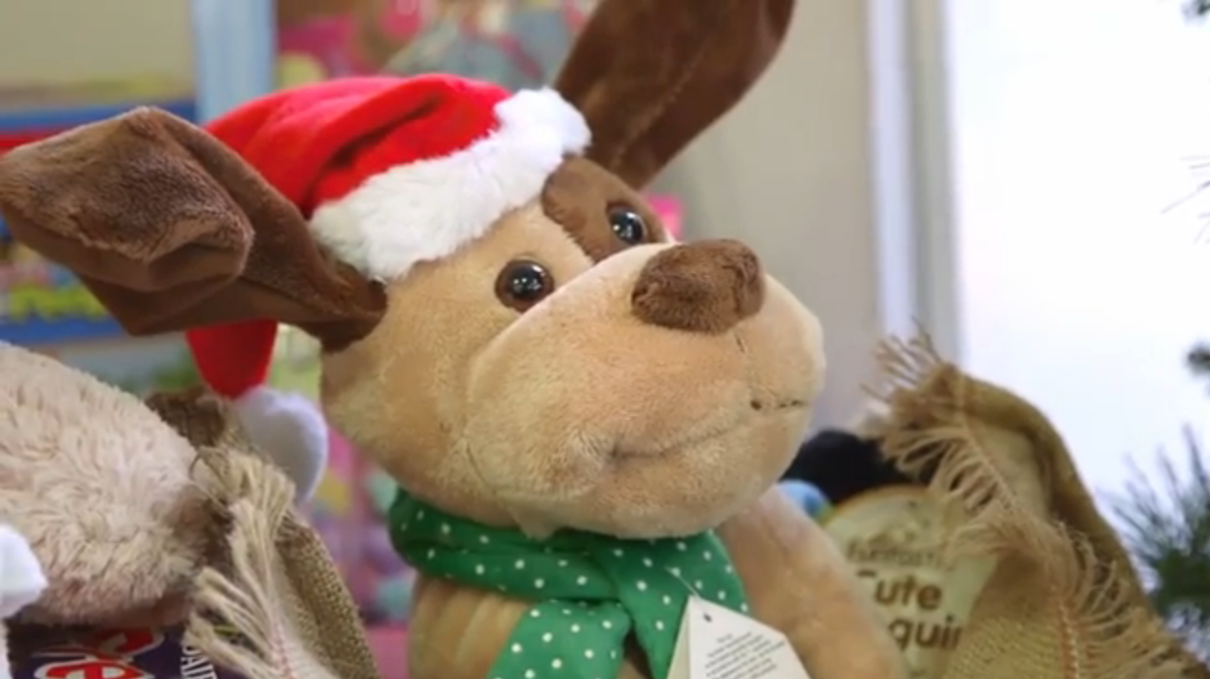
www.salvationarmy.org.uk/uki/christmas-present-appeal

Slide 9
Christmas Present ideas for Children
younger children
dolls and action figures, soft toys, cars, lorries,
colourful and fun educational toys,
colouring sets, DVDs, books, puzzles
older children and teenagers
games and toys, sports equipment and clothing,
stationery, CDs, DVDs, books, T-shirts,
hair ornaments, gloves, scarves, hats.

Slide 10
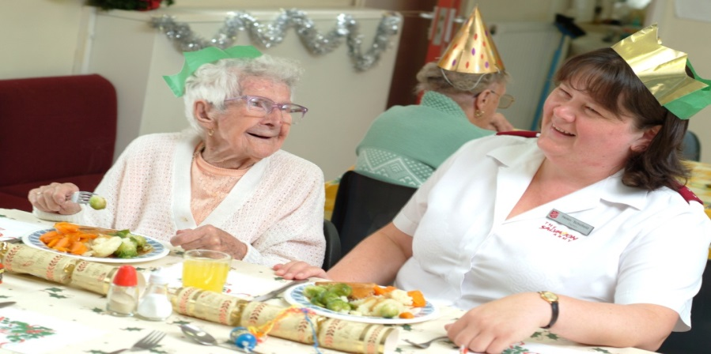
Christmas Present ideas for Older People
Bubble Bath
Scarves or hats
Books, or puzzle books
Speciality teas, jams, or biscuits

Slide 11
