Slide 2
Would you rather…?

Slide 3
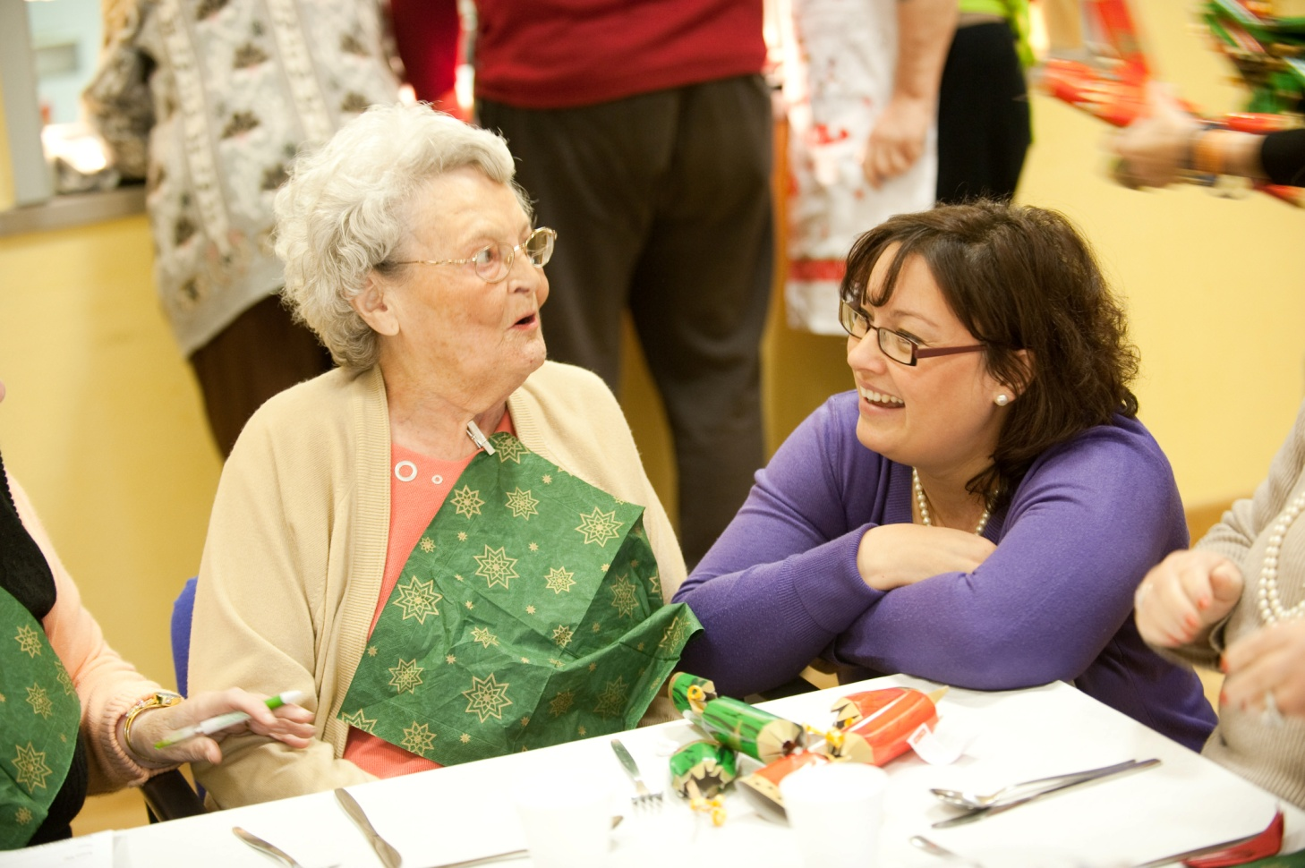
The Salvation Army at Christmas

Slide 4
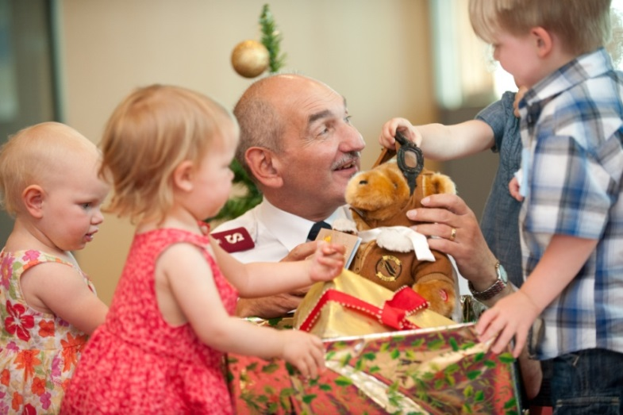
Christmas Present ideas for Children
Younger children
Dolls and action figures, soft toys, cars, lorries
Colourful and fun educational toys
Colouring sets, DVDs, books, puzzles
Older children and teenagers
Games and toys, sports equipment and clothing
Stationery, CDs, DVDs, books, T-shirts
Hair ornaments, gloves, scarves, hats

Slide 5
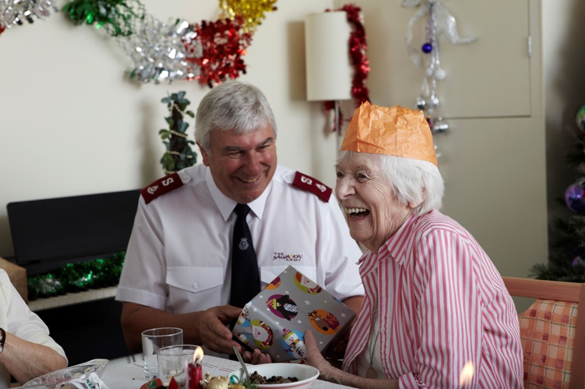
Christmas Present ideas for Older People
Bubble Bath
Scarves or hats
Books, or puzzle books
Speciality teas, jams, or biscuits

Slide 6
