Slide 1
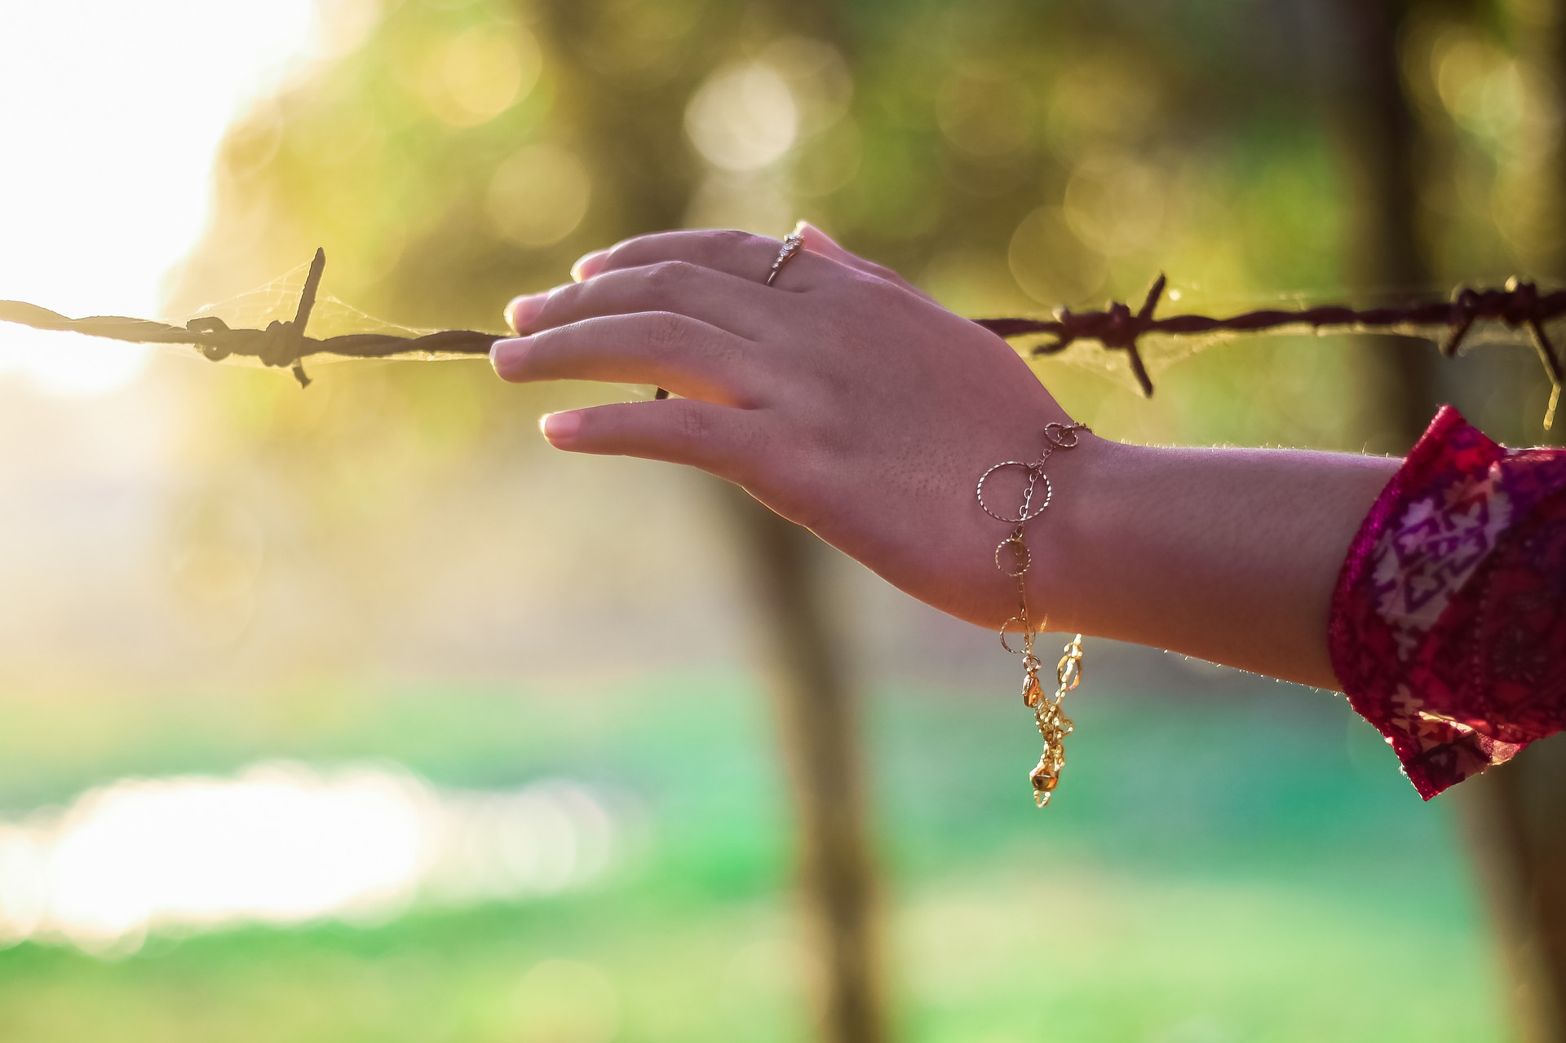
Anti-Slavery Day

Slide 2
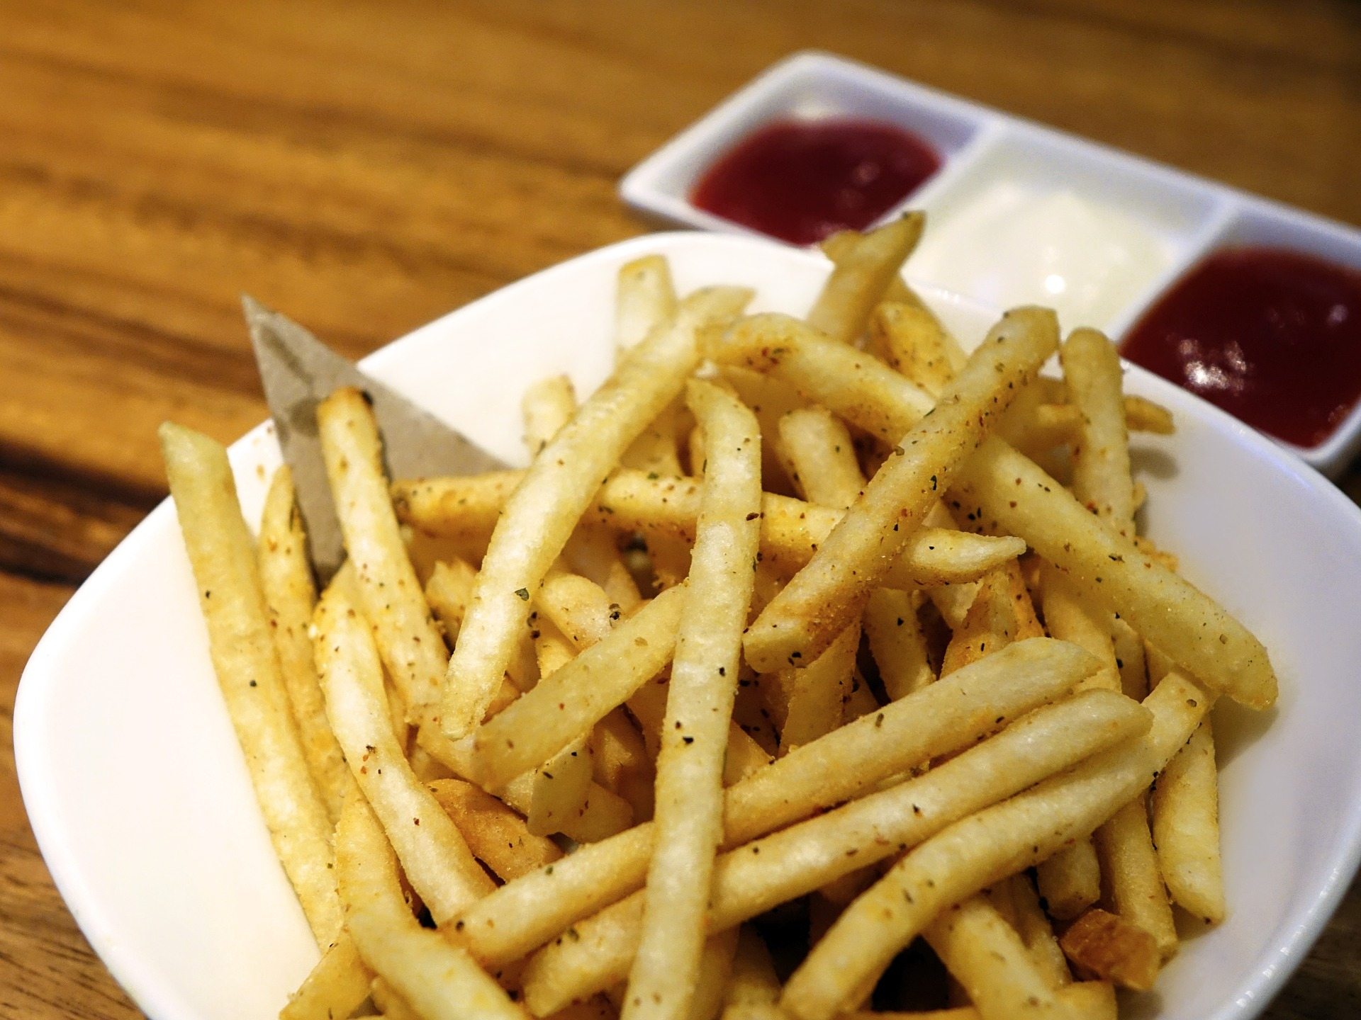
At lunch time you see someone steal a couple of chips from his friend’s plate when he’s not looking

Slide 3
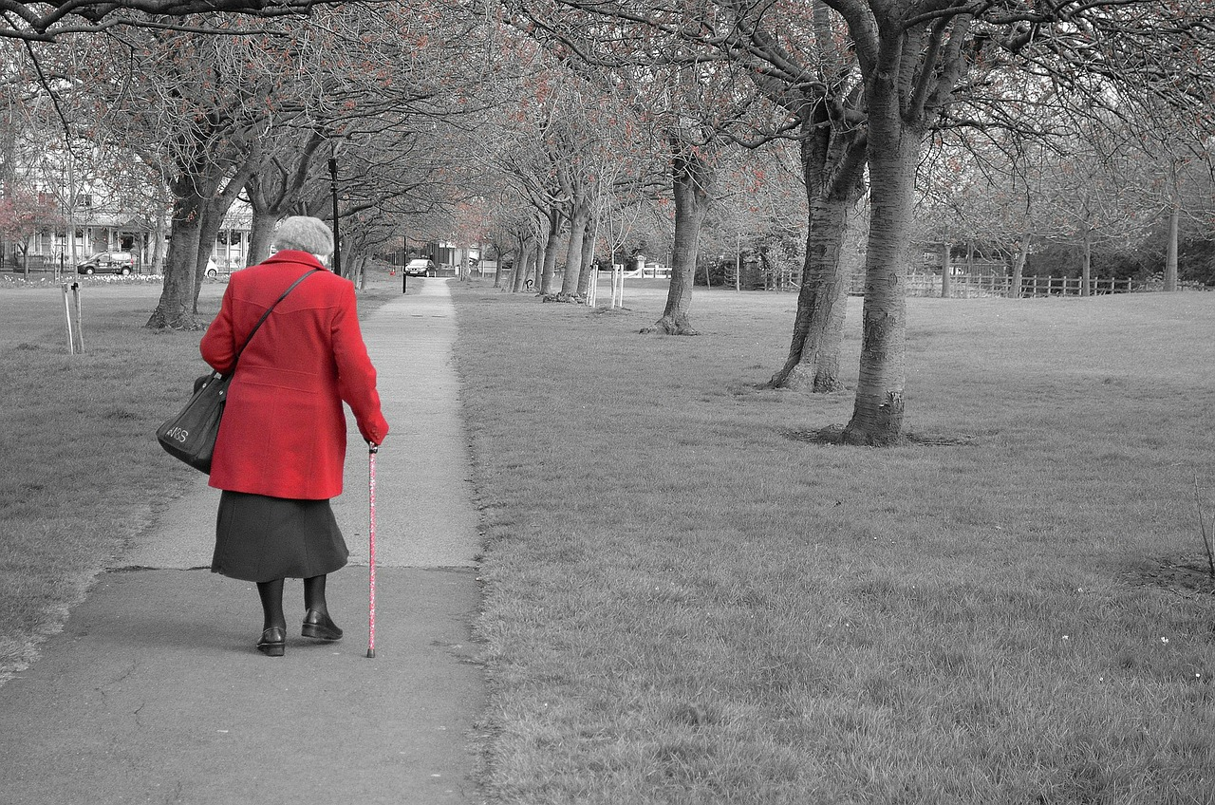
You see someone a couple of years older than you push past an elderly lady to get
on the bus, she almost
falls over

Slide 4
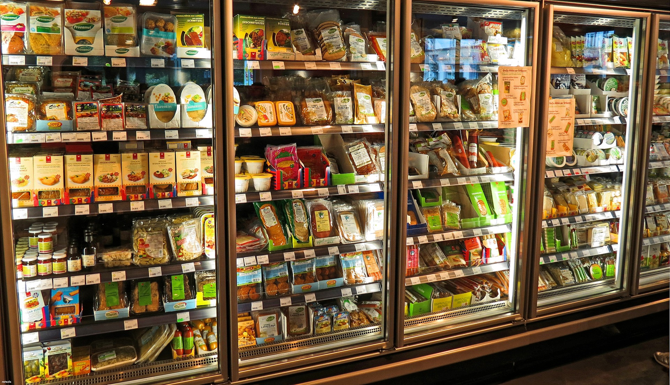
On your walk back from school you go to the supermarket, you see a
man take some sandwiches off the shelves and put them straight into his rucksack. He looks as though
he’s about to leave

Slide 5
You see a man shouting at a woman outside a house as you are walking home from your friends. The man seems to be getting more and more aggressive in his tone of voice and you
hear him say ‘you will regret disobeying me’ before he pushes her back into the house.

Slide 6
Speak up for those who cannot speak for themselves, for the rights of all who are destitute
Proverbs 31:8 NIV

Slide 7
Learn more and tell people
Write to your MP
Get involved with The Salvation Army’s campaigns

