Slide 1
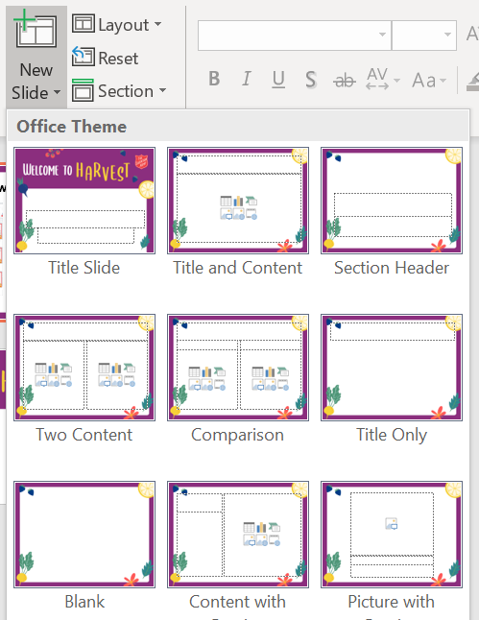
How to use
To add a new slide, on the Home tab click the text/small triangle of New Slide to open the drop-down menu of Slide types (don’t just click on the icon above, which simply adds whichever slide type you added last)
The Harvest design has been applied to the Master slide templates. Text box alignment and font sizes for all slide types should be optimised.
You can delete this slide whenever you like!

