Slide 1
Schools and Colleges
Unit

Slide 3
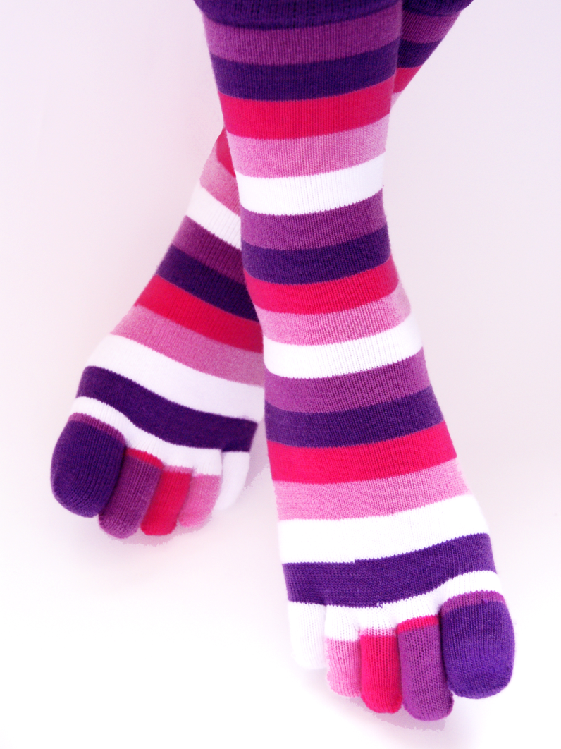

Slide 4
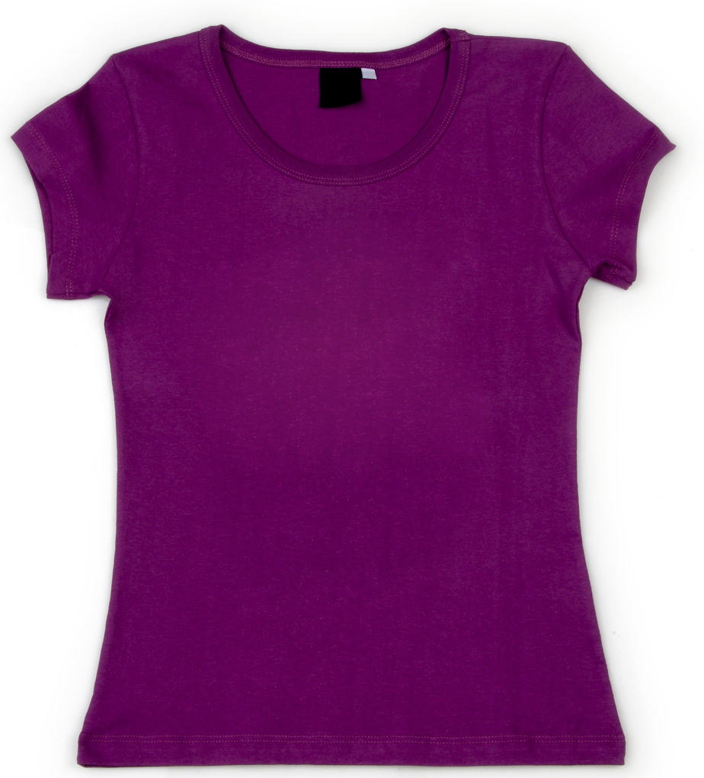
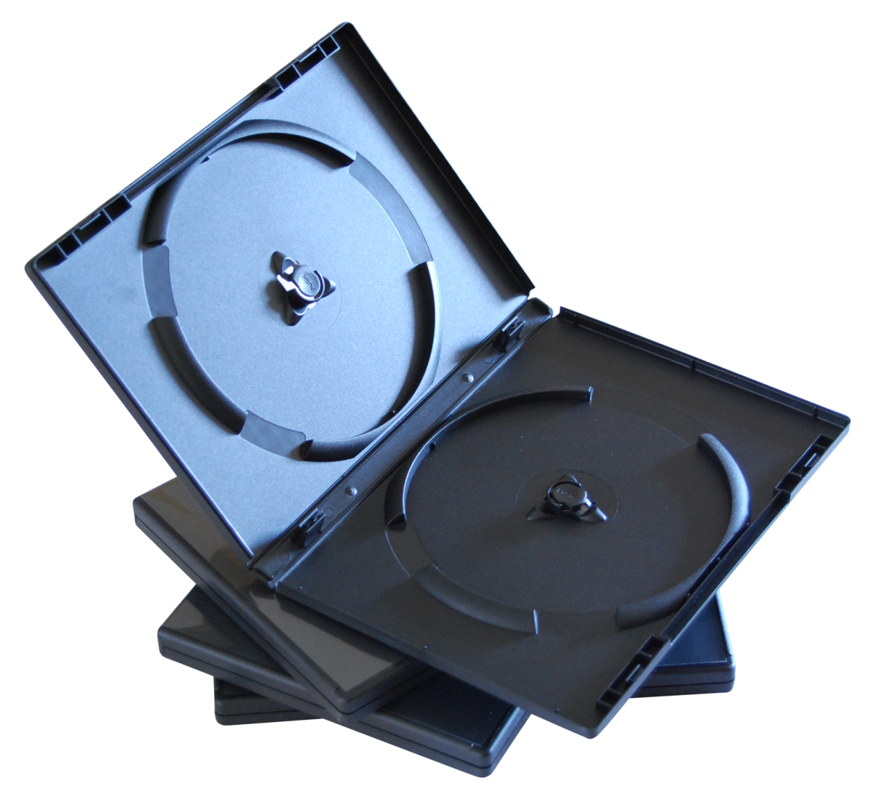

Slide 5
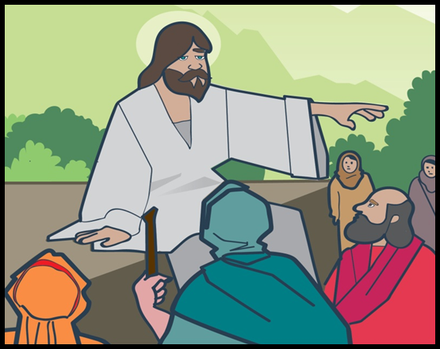
The thief comes only to steal and kill and destroy; I have come that they may have life, and have it to the full.
John 10:10

Slide 6
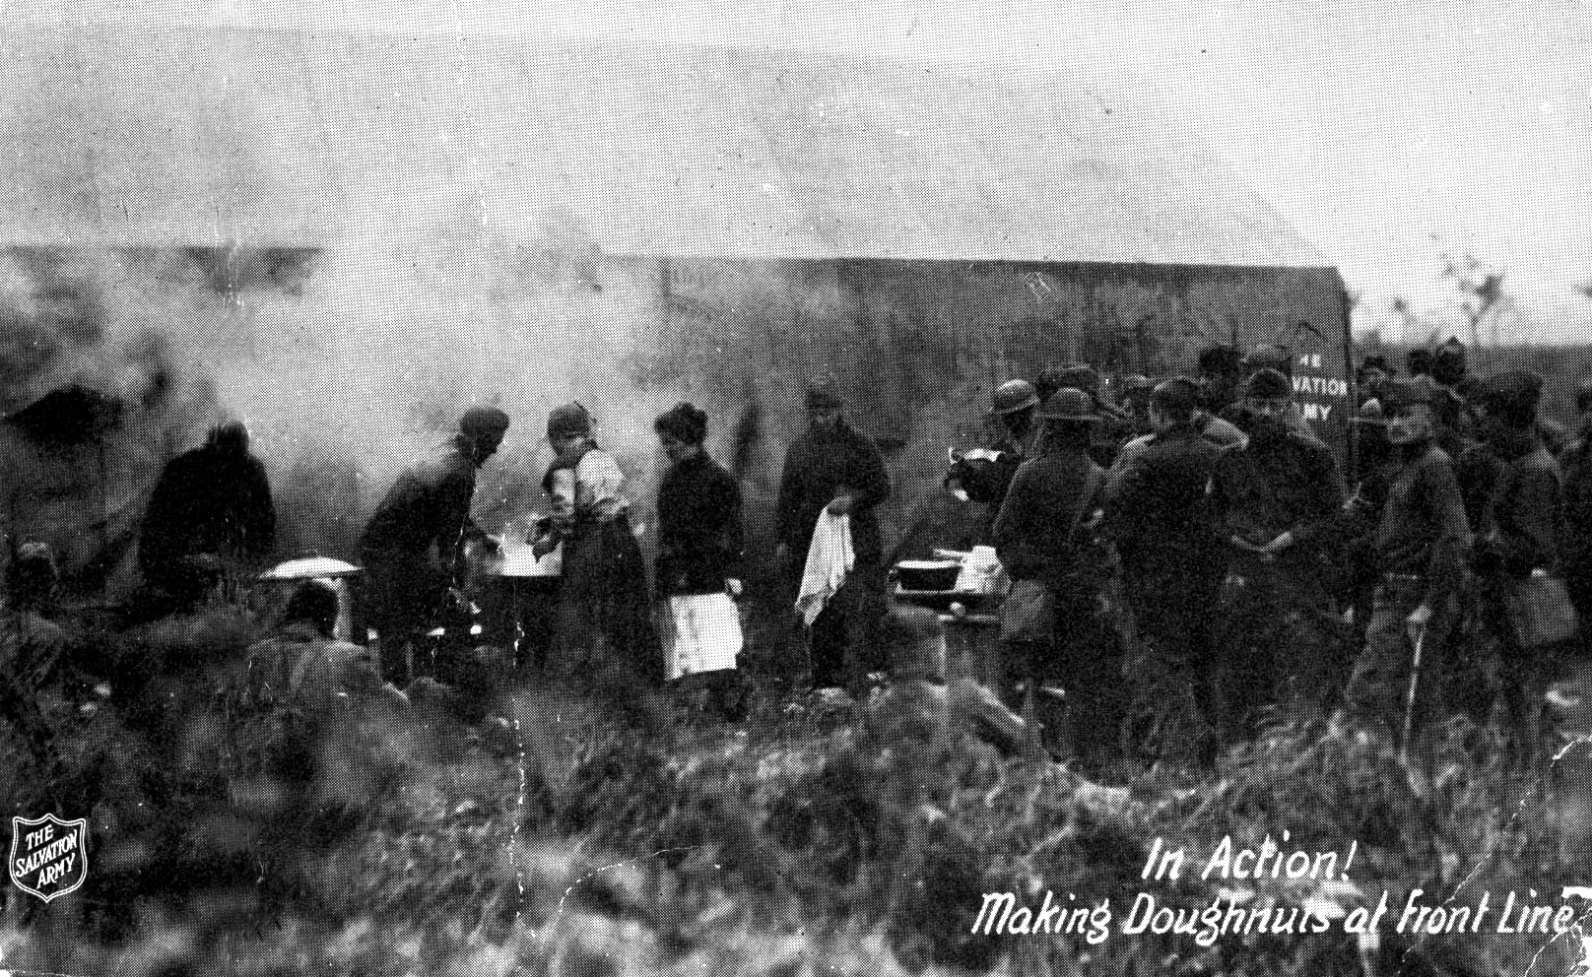

Slide 7
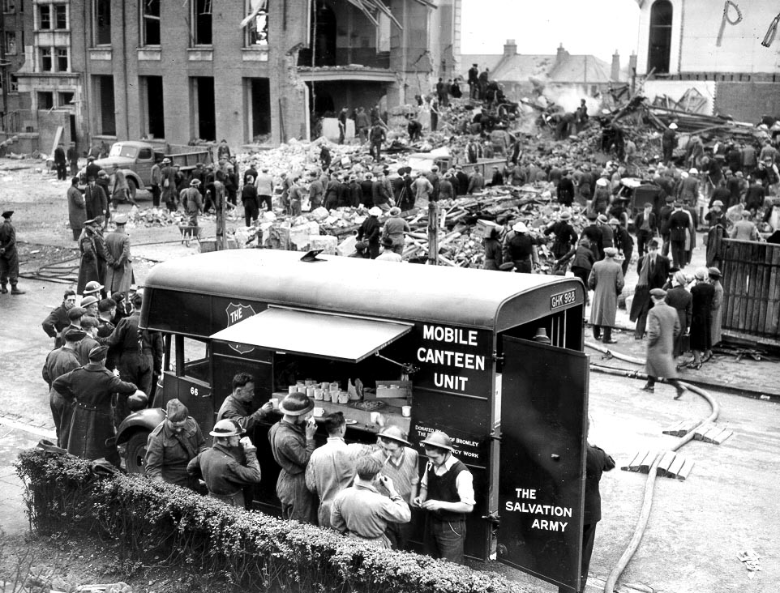

Slide 9
