Slide 1
Harvest 2014
Harvest
Giving Your All
Giving Your All

Slide 2
Who is giving more?
A Premier League footballer who earns £80,000 a week buys his wife a ring worth £3,000. A man earning the minimum wage serving in a restaurant (earning around £250 a week) buys his girlfriend a ring worth £125.

Slide 3
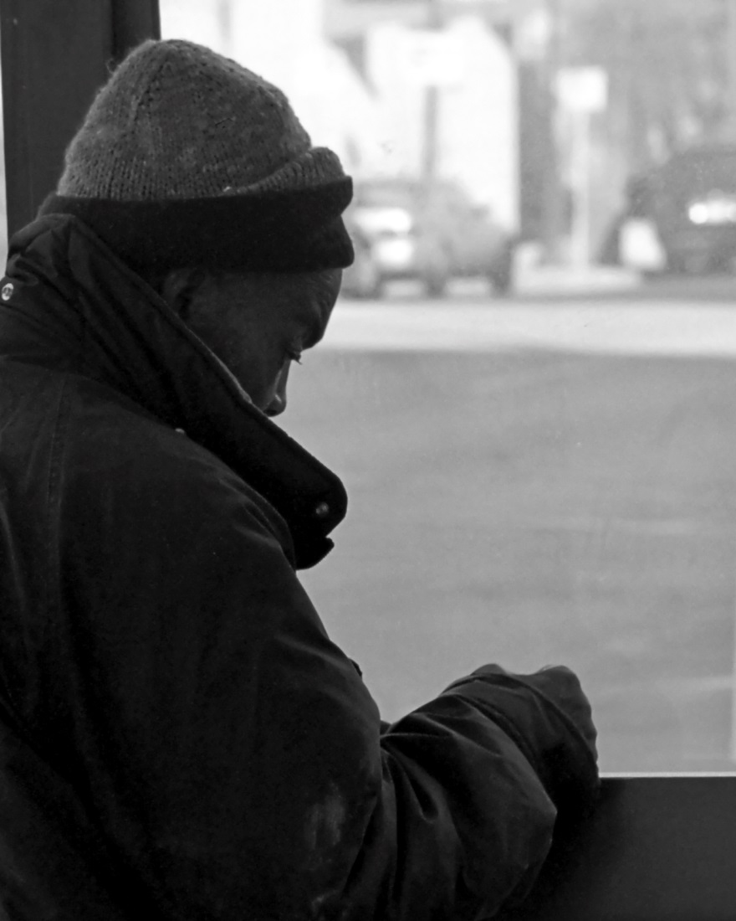
Who is giving more?
A friend of yours has five coats in his wardrobe at home. He sees a homeless man sitting on the street in just a T-shirt, so he goes home and gets two of his coats to give him. Another friend of yours has just one coat, sees a homeless man without a coat and gives him his one coat to keep.

Slide 4
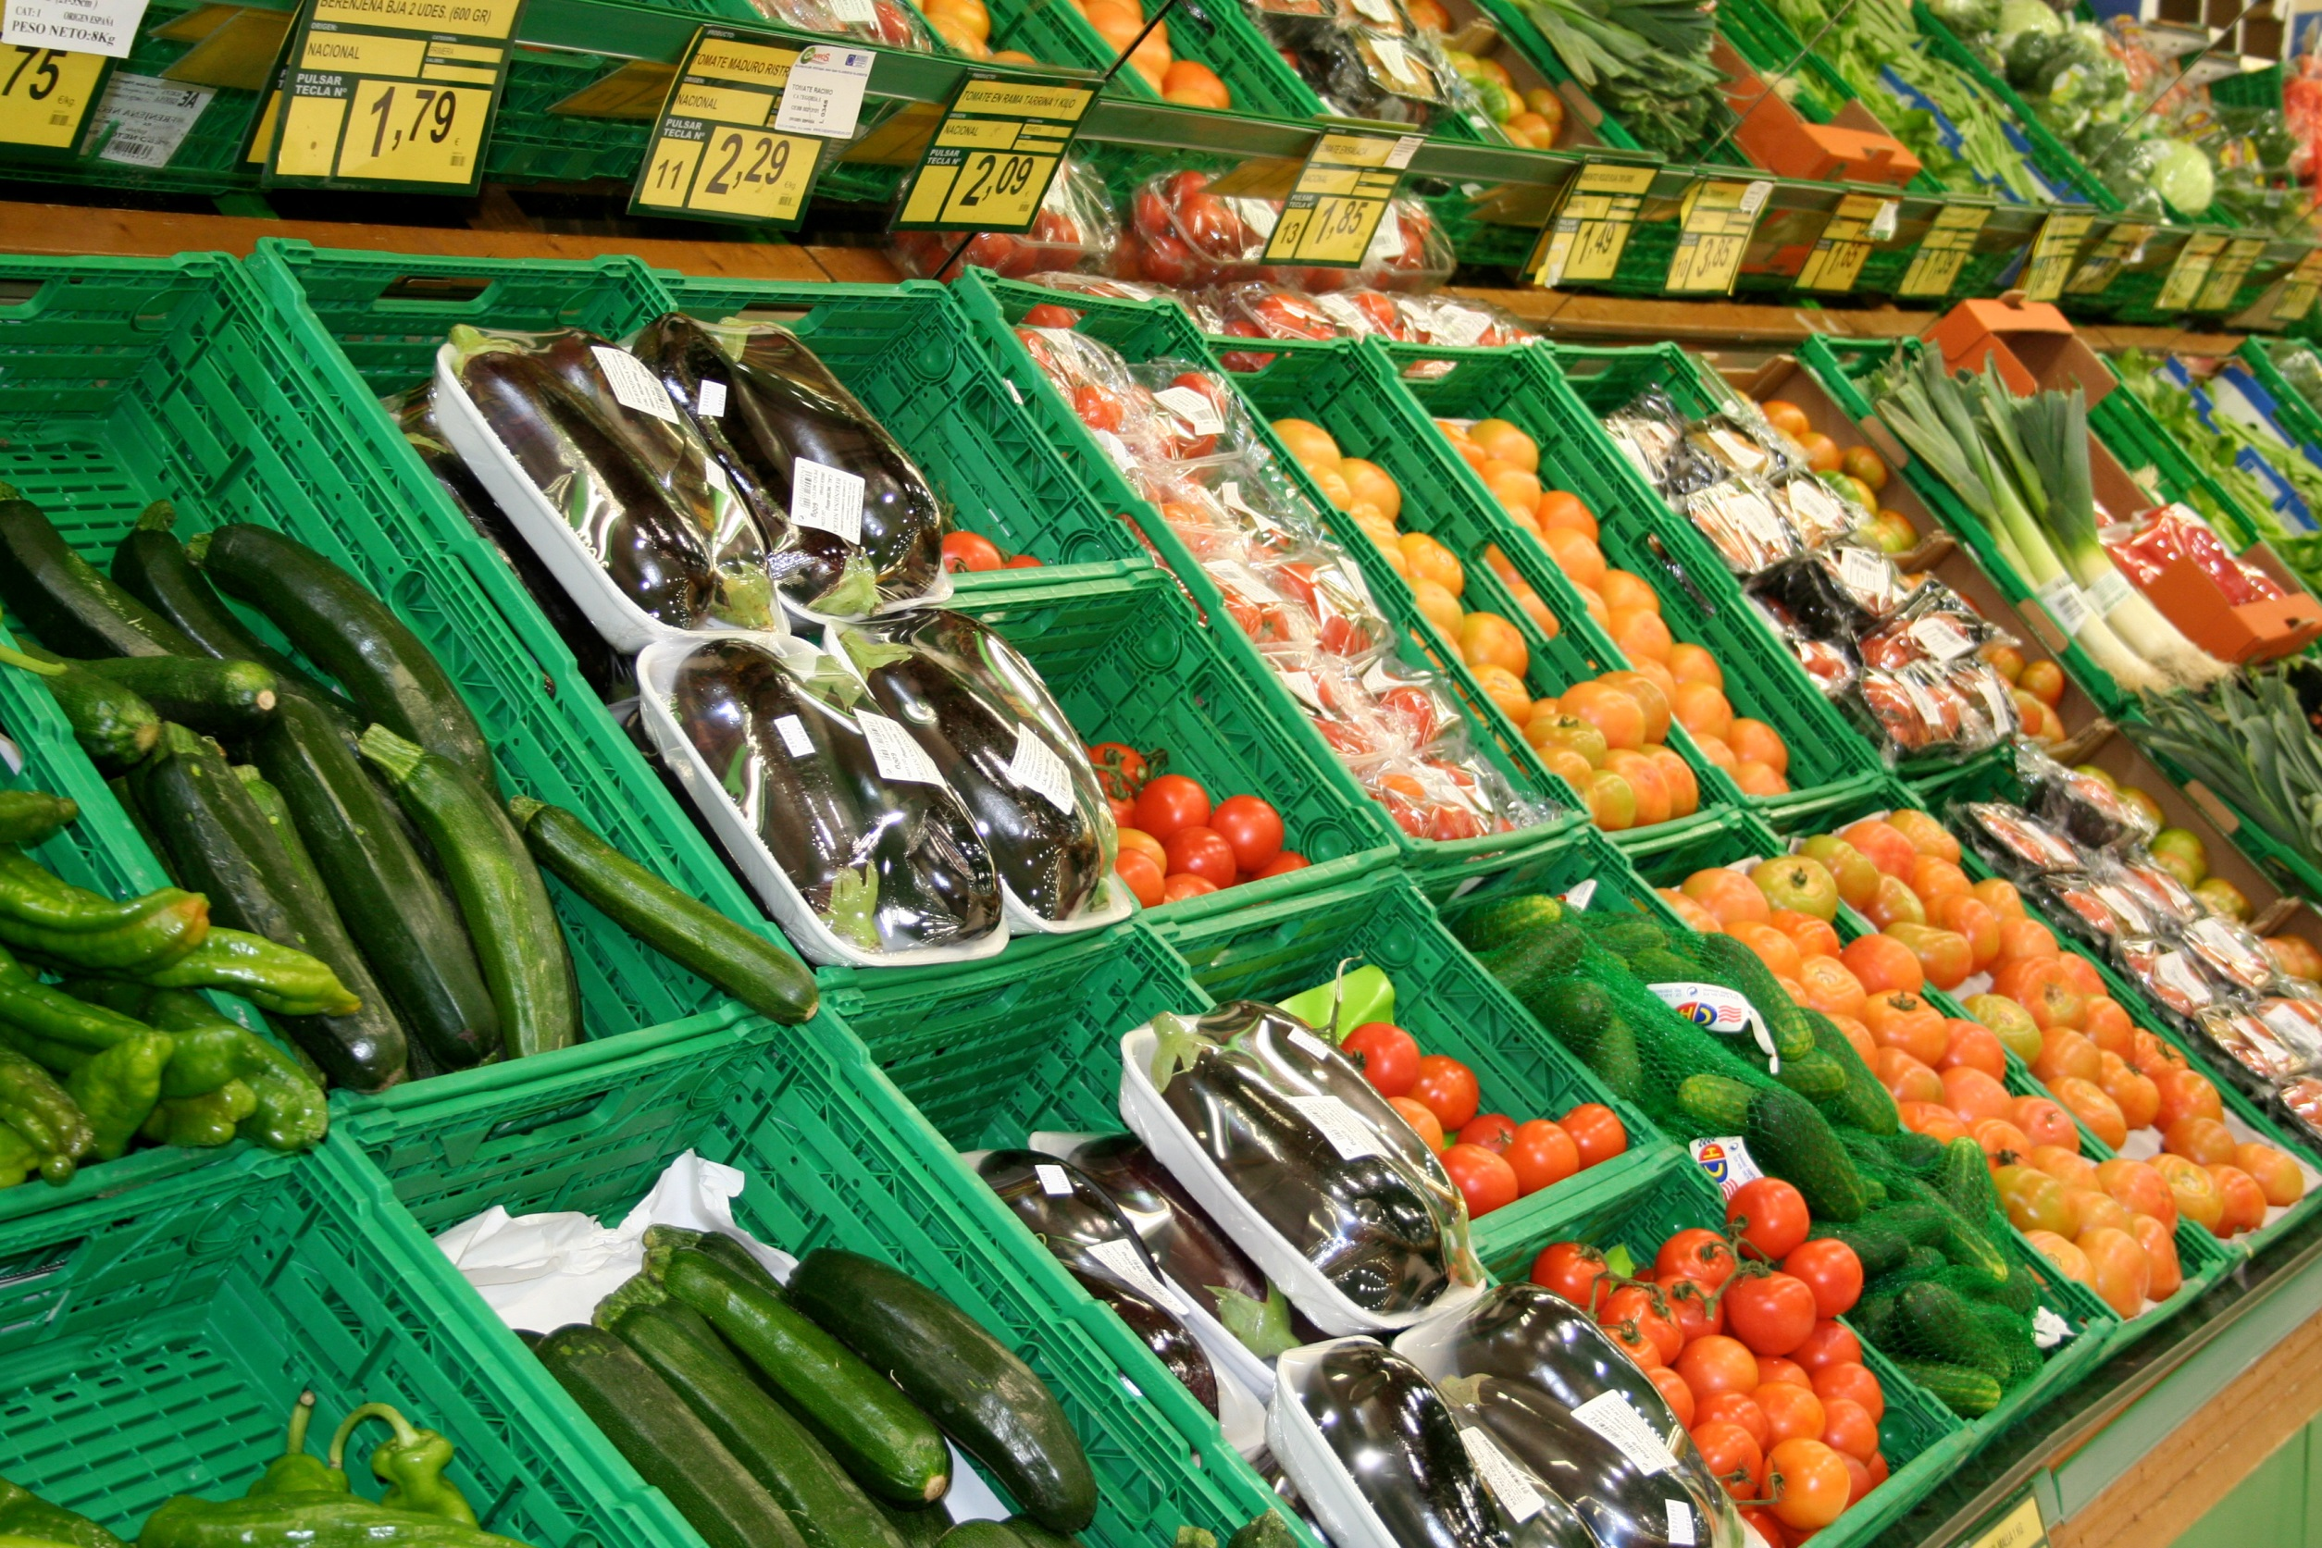
Who is giving more?
A nine-year-old boy has £10 weekly pocket money. He sees the food bank basket in the supermarket and asks his mum if he can spend half his money on food for the food bank. He spends his £5 on food for the food bank and his mum also buys £10 worth of food to put in the basket too.

Slide 5
The Widow’s Offering
41 Jesus sat down opposite the place where the offerings were put and watched the crowd putting their money into the temple treasury. Many rich people threw in large amounts. 42 But a poor widow came and put in two very small copper coins, worth only a few pence.
43 Calling his disciples to him, Jesus said, ‘Truly I tell you, this poor widow has put more into the treasury than all the others. 44 They all gave out of their wealth; but she, out of her poverty, put in everything – all she had to live on.’
(Mark 12:41–44 NIV)

Slide 6
The Widow’s Offering
‘All the others gave what they’ll never miss; she gave extravagantly what she couldn’t afford – she gave her all.’
(Mark 12:44 The Message)

Slide 7
13 million people in the UK live below the poverty line.
Every day people in the UK go hungry for a number of different reasons. It could be just an unexpected bill, loss of a job, illness, a delay in receiving benefits, debt or a family breakdown.
In 2013–14, food banks fed 913,138 people nationwide*
*Source: The Trussell Trust

Slide 8
The Salvation Army has around 700 churches (we call them ‘corps’) in the UK.
Many corps of The Salvation Army have always assisted those in need of food. It might have been in the form of a lunch club or a soup kitchen. Today one of the most common ways The Salvation Army helps those in need of food is by food parcels.

Slide 9
Each corps will make a response to calls for emergency food depending on what the needs are in the local area. Corps are encouraged to partner with food banks, but some run their own food banks or make a response that is less formal and meets the needs of individuals and families as needs arise.

Slide 10
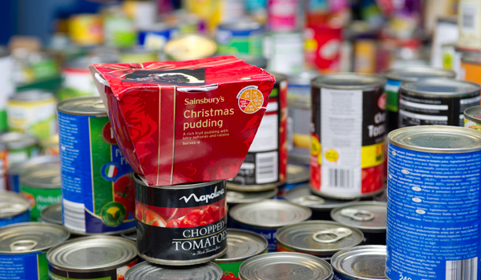
One Salvation Army corps in Preston runs a very busy food bank. Here’s what the officer, Captain Alex Cadogan, said about how the food bank is not just about reaching a need in an emergency but about helping individuals rebuild their lives:

Slide 11
‘The Salvation Army believes in focusing on the whole person.
Once you understand their issues and what’s causing their hunger, then you can begin the long and difficult work of helping that person get into a better situation for themselves and begin to reach their God-given potential.
Otherwise we will leave people to languish in poverty and depend on hand-outs for food beyond emergency situations, which is no road to dignity.’

Slide 12
How can you give
generously to others
this week?

Slide 13
Harvest 2014
Harvest
Giving Your All
Giving Your All

