Slide 1

ꢀ
Happening Now
•
•
Sunday Morning Service 10 am
Live streaming of our service
1. Goto Youtube
2. In the search bar put: Worthing Salvation Army
3. Click on the Scheduled date.
Happening This Month
Answers to Water Trivia:
1.Aqua
2.Hippopotamus
• Sunday 18th Harvest Festival 10 am
• Sunday 25th Corps & Befriending Service Anniversary 10 am
3.The Rime of the Ancient Mariner
(by Samuel Taylor Coleridge)
4.Wind-water
5.Bourton-on-the-Water
6.Water Displacement
7.Leonardo da Vinci
8.Coniston Water
More info?
•
•
•
Website: www.salvationarmy.org.uk/worthing
Facebook: Worthing Salvation Army
Email: worthing@salvationarmy.org.uk Tel: 01903 234497
9.Hydrangea
10.Buxton

Slide 2

ꢀ
Why can’t we live without the Water of Life?
Whilst man can live physically for three weeks without
food, or only three days without water, Jesus said to
Nicodemus, “No one can enter the Kingdom of God
without being born of water and the Spirit.
Solomon, who wrote this proverb, used the picture of a well of water to point us to
our need to guard our heart. Just as physical life depends on water so our
spiritual life depends on us having a pure heart.This happens when we ask the
Lord to forgive us and share our lives.
Our actions come from the things we think
and believe.
When our heart is right and pure, we can
obey God’s word and apply it to our lives.
Here is a prayer we can pray each day.

Slide 3
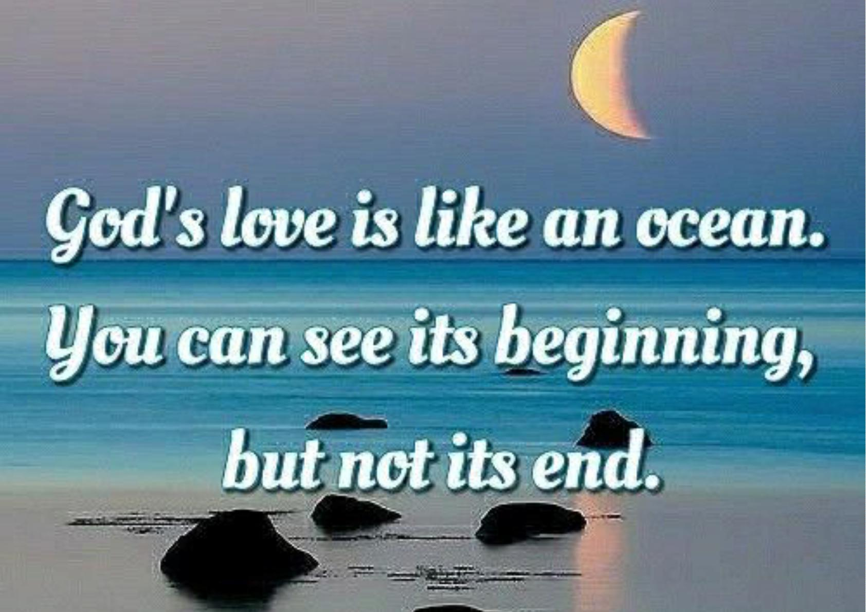

Slide 4
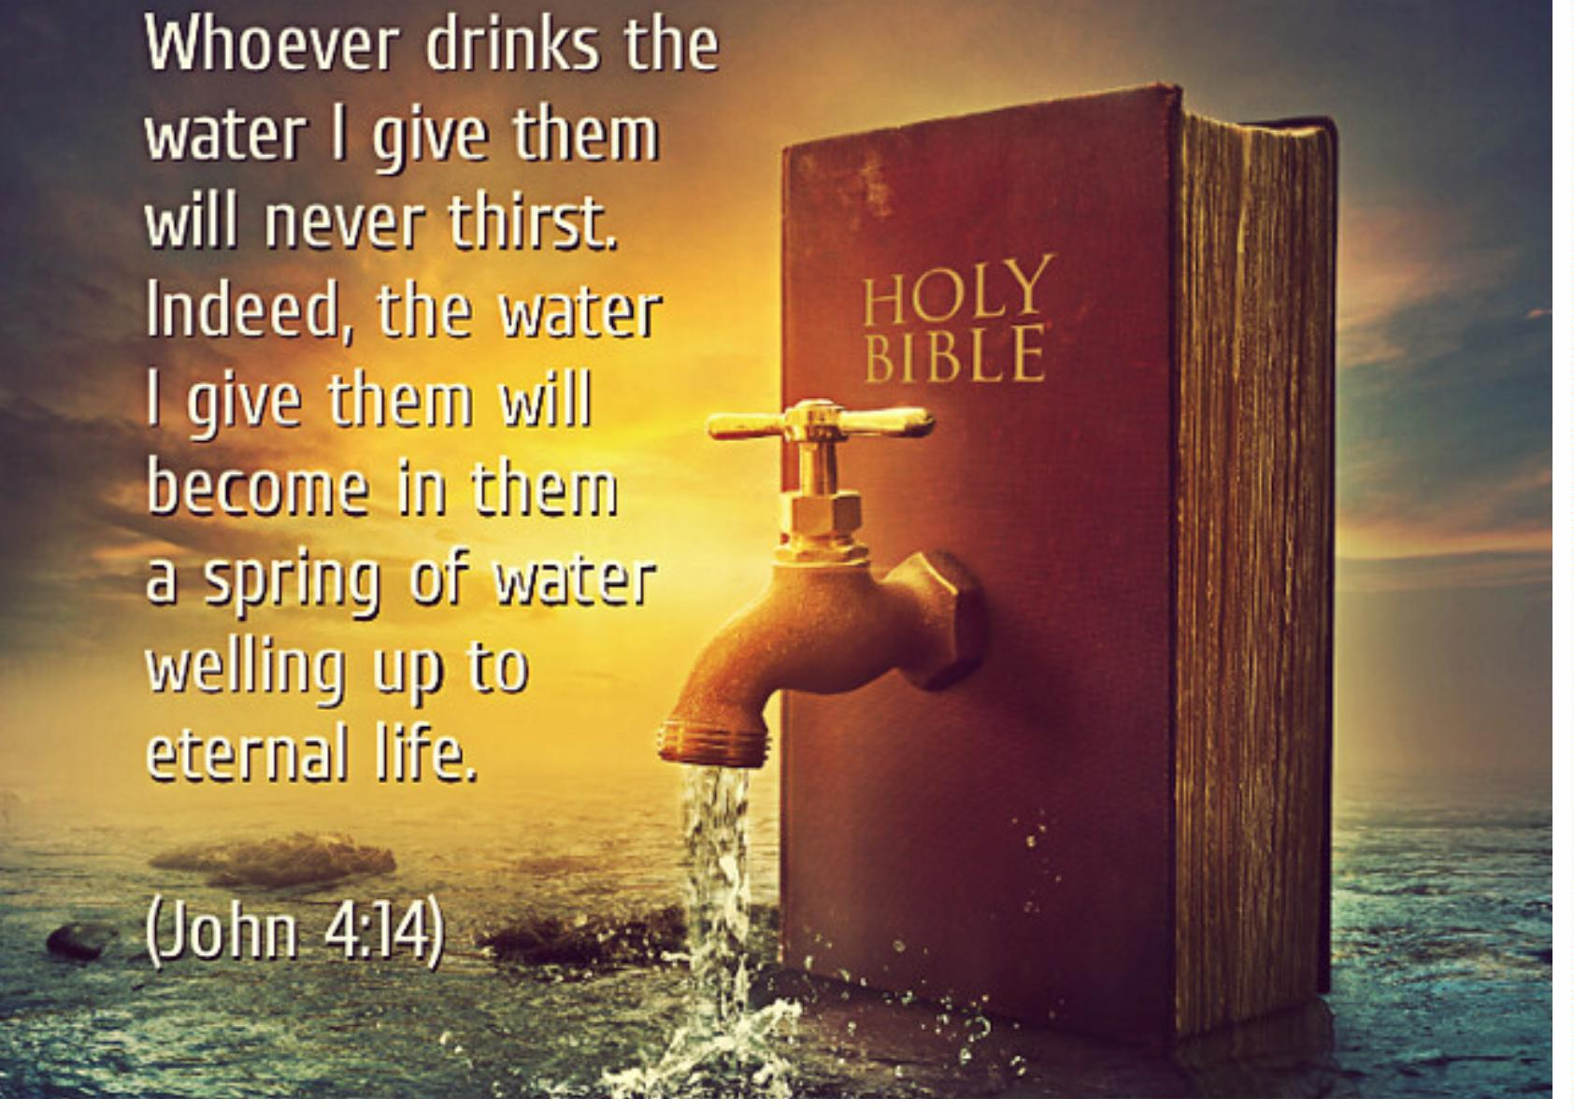

Slide 5
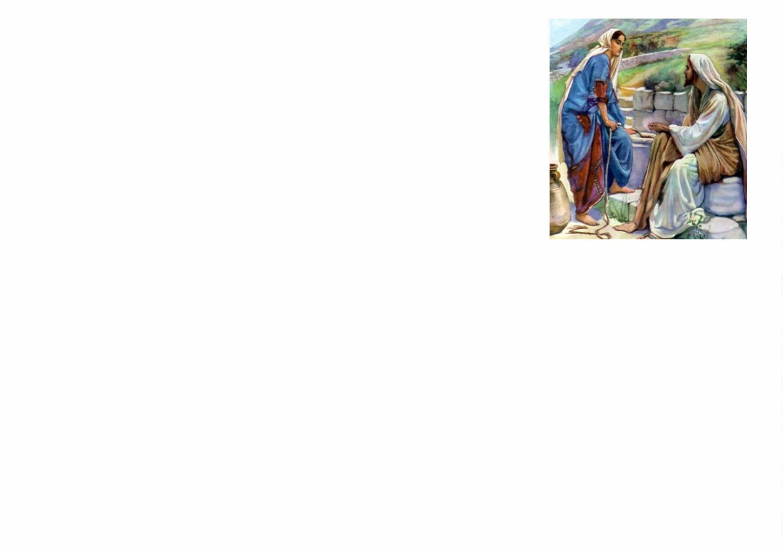
Jesus offers us life giving water.
Jesus was tired and so He sat by a well whilst His disciples
went to get food. A woman came to the well to get some
water and Jesus asked her for a drink. She was surprised
that a Jewish man would ask her, a Samaritan woman, for
anything!
But Jesus knew that this woman’s heart could be healed
and her life changed. He knew that it didn’t matter what
she was on the outside because He could ﬁll her on the inside.
Jesus told her that He had water that would keep her from ever being thirsty
again. “Yes, please”, she said. “I would like that!” So He gave her this answer.
“The water that I will give you will become in you a spring of water welling up to
eternal life.”
When we invite the Lord to share our lives, a river of life giving water starts to ﬂow
that will bring us into His eternal Kingdom.
Prayer: Father, like the Samaritan women, I come to You, needing everything.
Forgive me, live within me, and let Your living water ﬂow in me. Amen

Slide 6
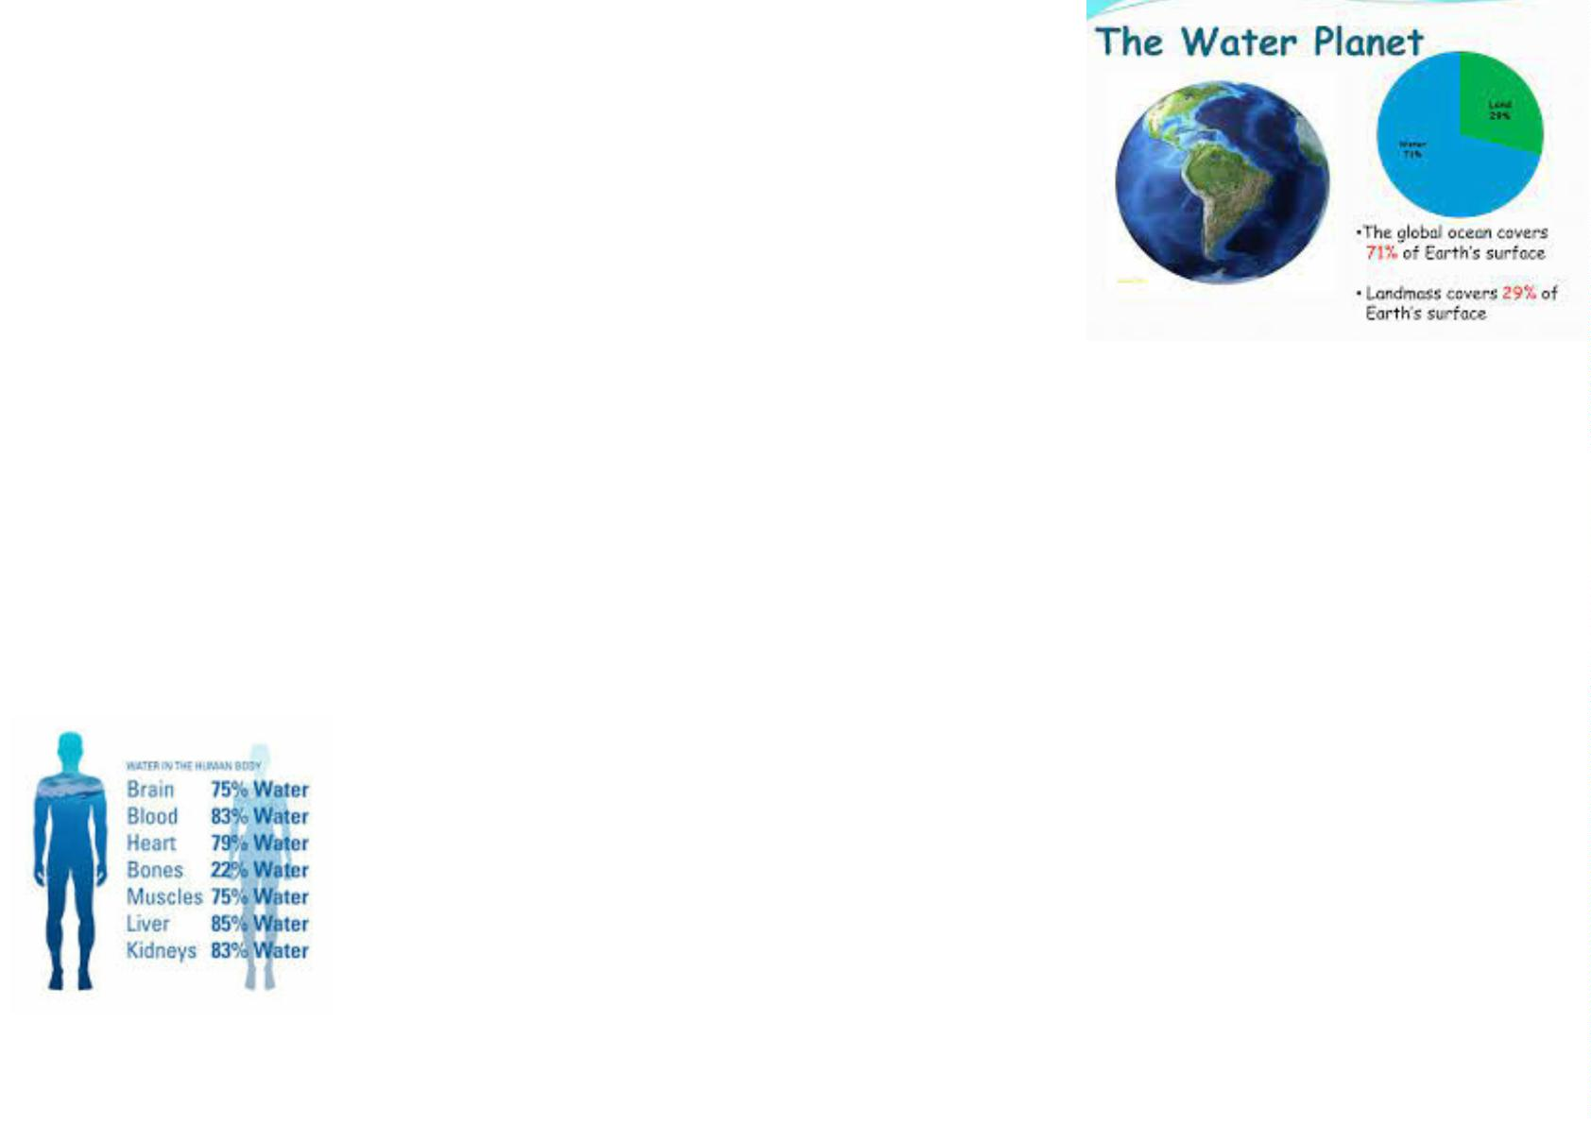
Why can’t we live without water?
•
With about 71% of our world covered with water
and about 60% of our bodies made up of water - we
live on a water planet!
•
•
Water is a solvent, allowing other substances to dissolve in it, meaning that
water carries minerals and nutrients to every part of our body.
Water also regulates body temperature, moistens tissues in ear, nose and
throat, and enables our kidneys and liver to flush out waste products.
So what should we do?
Drink it. Every day, we lose water through your breath,
perspiration, urine and bowel movements, which is why it’s
important to continue to take in water throughout the day. For
your body to function at its best, you must replenish its water
supply with beverages and food that contain water.

Slide 7

Water! Water everywhere and not a drop to drink!
Teacher: “What is the chemical formula for water?” Student: “HIJKLMNO”.
“What on earth are you on about?” “But sir, yesterday you said it was H to O!”
Q: What did the rain drop feel when it hit the window? A: A pane.
The police arrested a water bottle. It was wanted in three different states.
Liquid, solid, and gas.
Teenage boy, “Dad, there’s trouble with the car; it has water in the
carburettor.” Dad says, “Water in the carburettor? You don’t even know what
a carburettor is…. but I will sort it. Where is the car?” “It’s in the river!”
In recent news there has been a string of thefts at police stations in the
city. The burglars have stolen dozens of toilets. It’s a mystery who is behind
these thefts. The investigators have nothing to go on.
Thirty people are sheltering under an umbrella. How
many of them get wet? None. Who said it was raining?

Slide 8
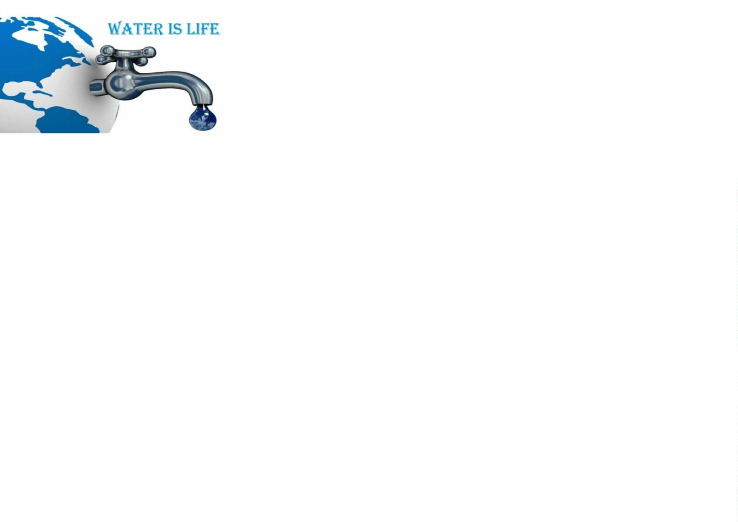
Water Trivia!
1.What is the Latin word for water?
2.What animal's name comes from the ancient Greek
for "river horse?”
3. From which poem: ”Water, water, every where, nor any drop to drink?”
4. The term “feng shui” literally translates as what two words in English?
5. Which Cotswolds village has the nickname of "Venice of the Cotswolds"
6. What does the 'WD' stand for in the brand name WD40?
7. Which artist said: "Water is the driving force in nature"?
8. Name the third-largest lake in the Lake District by volume after
Windermere and Ullswater?
9. Which flowering plant is derived from the Greek meaning “water vessel?”
10.Where is St Ann's Well, a Derbyshire ancient warm natural spring?”

